Slide 1

Data and Advanced Features
Speaker Name
Notes:
Content as of end of Nov 2023

Slide 2
Agenda
On Your Data
Azure AI Search
Microsoft Fabric
Cosmos DB
Function Call
Whisper Model

Slide 3
On Your Data

Slide 4





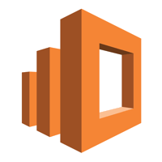

Azure OpenAI Service on your data
Data Sources
(search, files, databases, storage etc.)
API & SDK
App or Copilot agent
Azure OpenAI
Service on your data
Additional 3P Data Sources
(files, databases, storage data etc.)

Slide 5


Retrieval Augmented Generation (RAG) Anatomy of the workflow
Retriever over Knowledge Base
Query for relevant content
R
Search results
User question
Answer
Prompt + Knowledge
A
G
Large Language Model
Response
App UX
Orchestrator

Slide 6
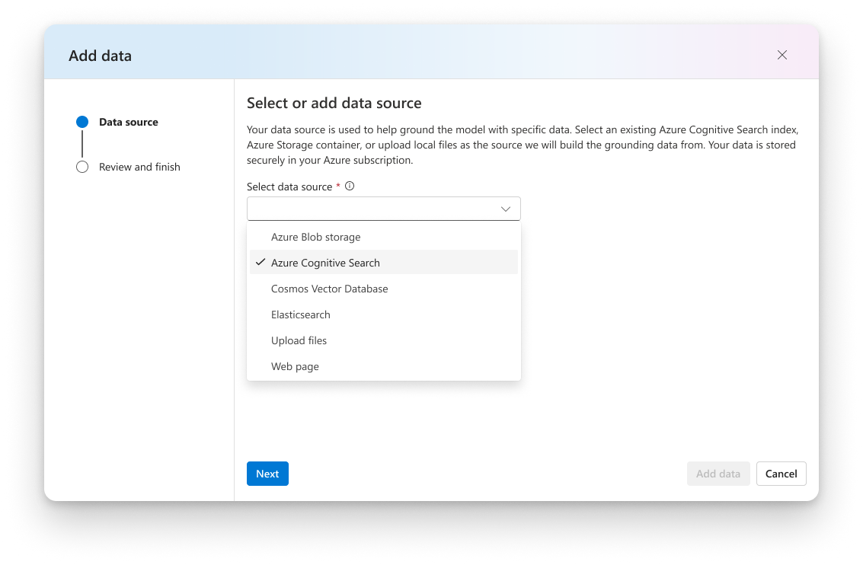
Integrate Structured & Unstructured Data
Blob storage
Azure Data Lake (ADLS)
Fabric OneLake
Local files/folders
S3 via OneLake shortcut
Azure AI Search

Slide 7
Retrieval Augmented Generation
User Question
LLM Workflow
Query My Data
Search Index
Add Results to Prompt
Query Model
Large Language Model
Send Results

Slide 8



Retrieve Using Semantic Similarity and Hybrid Search
Embedding
[0.023883354, 0.021508986,
0.044205155, 0.019588541,
0.031198505, …]
Find the most relevant information in large datasets using hybrid search with keywords, vectors, and semantic ranker

Slide 9
RAG with Azure data products
Product | Native vector indexing OR Azure AI Search | Details
CosmosDB - MongoDB vCore | Native | Vector Search - Azure Cosmos DB for MongoDB vCore | Microsoft Learn Has free tier with dedicated MongoDB cluster with 32-GB storage. This feature is currently available in East US, West Europe and Southeast Asia regions. Free tier - Azure Cosmos DB for MongoDB vCore | Microsoft Learn
Azure Database for PostgreSQL | Native | Supported in Flexible Server using pgvector [GA] and azure_ai [in preview] extension Semantic search with Azure Database for PostgreSQL Flexible Server and Azure OpenAI | Microsoft Learn
Azure Cache for Redis | Native | Supported in the Enterprise tiers About Vector Embeddings and Vector Search in Azure Cache for Redis - Azure Cache for Redis | Microsoft Learn
CosmosDB - PostgreSQL | Azure AI Search | No free tier
CosmosDB - MongoDB | Azure AI Search | Free for first 1000 RU/s and 25 GB of storage in the Cosmos DB account Azure Cosmos DB free tier | Microsoft Learn
CosmosDB - NoSQL | Azure AI Search | Free for first 1000 RU/s and 25 GB of storage in the Cosmos DB account Azure Cosmos DB free tier | Microsoft Learn
AzureSQL | Azure AI Search | One free serverless database with the first 100,000 vCore seconds, 32GB of data, and 32GB of backup storage free per month per subscription Azure SQL Database free offer - Azure SQL Database | Microsoft Learn
Fabric OneLake | Azure AI Search | Provides capability on connecting external datasources without data movement What is OneLake? - Microsoft Fabric | Microsoft Learn Has 60 free trial on paid featrues

Slide 10


Intelligent apps with Azure SQL
https://aka.ms/sql-ai
Flexible, real-time data accessibility
Simplified human interaction with reliable AI assistance
Enterprise requirements for the Era of AI
Comprehensive generative AI outcomes with data from all sources and types
Eliminate data silos with scalable, reliable, secure data
Natural language interaction
Accurate responses leveraging relevant data and context
Azure Cognitive Search+SQL
Scalability
SLA-backed business continuity
Built-in security and compliance
Cost-effective
Fully managed and scalable
built-in Open AI integration
CoPilots and Vector Search
Cloud-native engine
Data foundations to accelerate time-to-market for AI apps development ​

Slide 11

AI ready Database
Built for semi-structured data
Built-in vector search
Native support for MongoDB vCore and PostgreSQL APIs
Integrated with Azure Cognitive Search for core NoSQL API
Coming soon: native vector search for core NoSQL API
High performance and elasticity, great for multi-tenant apps

Slide 12

Announcing
New AI capabilities for Azure Database for PostgreSQL
Azure AI extension - preview
Pg Vector extension support 0.5.1 - GA

Slide 13
Azure Database for PostgreSQL—Intelligent apps
Azure AI extension
Vector data type
SQL Interface to Azure OpenAI
Create embeddings from SQL Statements
SQL interface to Azure AI Language services
Complimentary to vector data type
Pg Vector extension update—0.5.1 GA
Vector data type—natively store embeddings
Vector indexing for performant searches
Efficient similarity searches within the DB

Slide 14
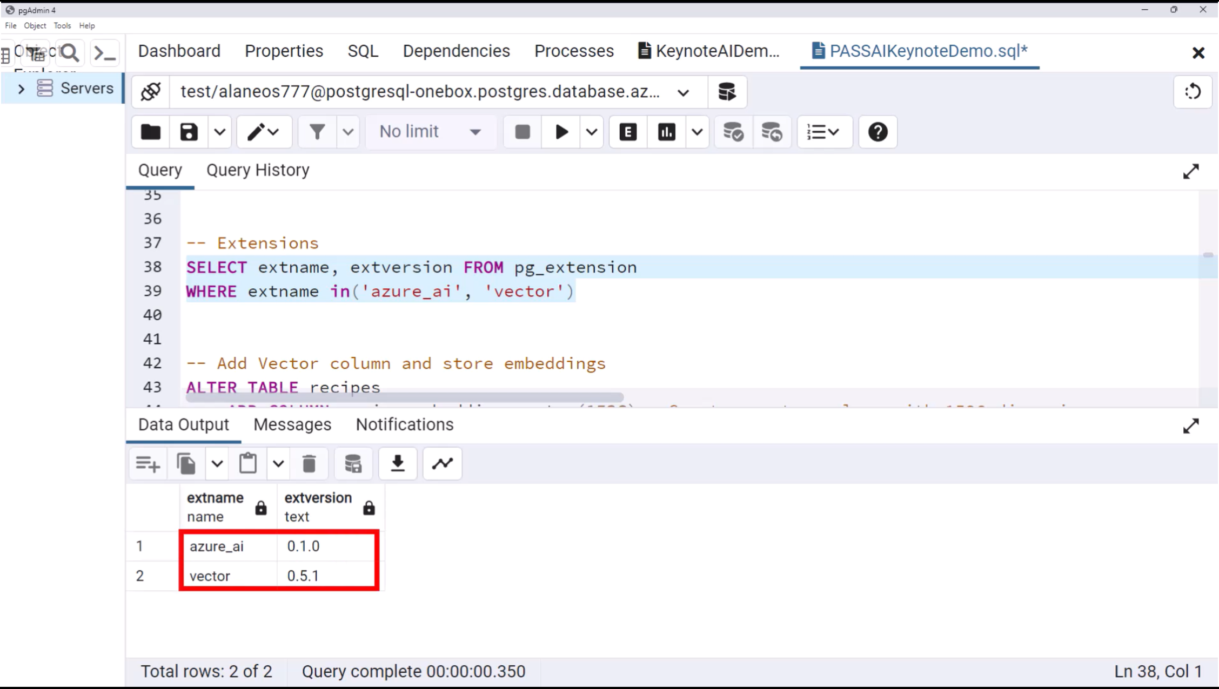

Slide 15
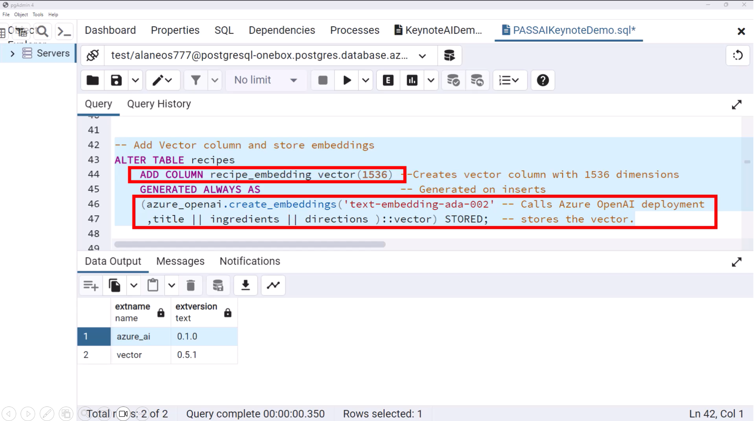

Slide 16

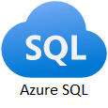



Enterprise Q&A Bot Architecture
User account info
User’s identity
Access Control
Domain of User’s question
Formulate Prompt
User’s question
Azure OpenAI Service
Embedding Search
or
Fine-tuned GPT Intent Classifier
LLM model
Search from domain-specific KB/DB
Return response to user
Knowledge Bases & Data Bases

Slide 17
Concepts Shown in Demo
Q&A Bot for a fictitious company called Contoso which sells Surface devices
Use Natural Language to access a SQL DB, and get natural language responses via GPT4
DB has fictitious sales and inventory info for Surface devices
This info is spread across multiple tables
Answer user’s questions using a Knowledge Base and ChatGPT – uses Azure AI Search
KB is populated with Microsoft public docs for Surface devices
Documents are ingested using Document Intelligent
One Bot which integrates both “structured” (SQL) and “unstructured” (web pages/docs) data with ChatGPT / GPT4
Using Role Based Access Control (RBAC) to restrict access to certain info
SQL DB is accessible only to members of the Sales organization
Repo associated with this demo: openai/End_to_end_Solutions/AOAISearchDemo at pmishra/AOAI_with_CogSearch_and_Sql · Azure-Samples/openai · GitHub

Slide 18
Demo
Links to recorded demos: There are two pre-recorded voiceovers that shows how enterprises can use this architecture for their different users/audiences. The demo uses two different personas:
Emma is marketing lead demo
Dave is regional sales manager demo

Slide 19
Azure AI Search

Slide 20


Azure AI Search
Feature-rich vector database
Ingest any data type, from any source
Seamless data & platform integrations
State-of-the-art search ranking
Enterprise ready foundation

Slide 21
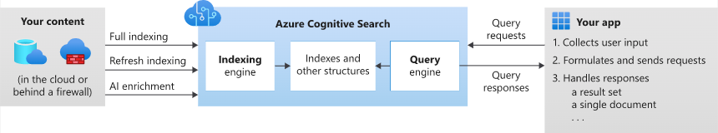
Azure AI Search
Formerly known as "Azure Cognitive Search"
Cloud search service that gives developers infrastructure, APIs, and tools for building a rich search experience
Capabilities
A search engine for full text and vector search over a search index containing user-owned content
Rich indexing, with lexical analysis and optional AI enrichment for content extraction and transformation
Rich query syntax for vector queries, text search, fuzzy search, autocomplete, geo-search and more
Programmability through REST APIs and client libraries in Azure SDKs
Azure integration at the data layer, machine learning layer, and AI (Azure AI services)

Slide 22
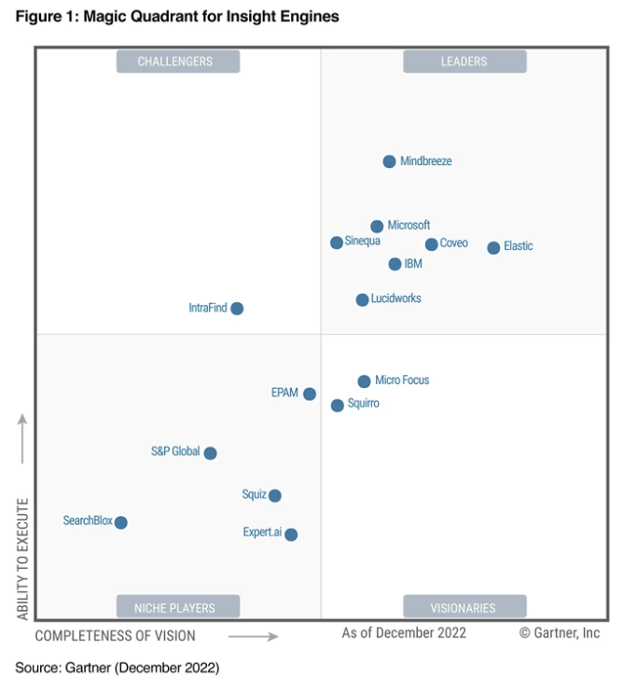
A leader in the industry…
“Microsoft is a Leader in this Magic Quadrant. Its Microsoft Search and Azure Cognitive Search products are broadly focused on EX and CX applications for digital workplace search and custom applications, respectively.”
Gartner Magic Quadrant, Insights Engine, 2022
©Garner, Inc

Slide 23

Querying Modes
Retrieval
Ranking
Often called L1, the goal is to quickly find all the documents from the index that satisfy the search criteria. These are scored to pick the top few (typically in the order of 50) to return to the user or to feed to the next layer. Azure Cognitive Search supports (3) different L1 modes:
Also called L2, takes a subset of the top L1 results and computes higher quality relevance scores to reorder the result set.
Keyword
Vector
Hybrid
Semantic Ranking
Exact keyword based
Relevance via Boolean Search
Ranking via BM25 probabilistic model
Vector representation of your data
Uses power of vector and semantic
AI Search currently uses Reciprocal Rank Fusion (RRF) to produce a single result set
Formerly known as "semantic search"
Utilizes multi-lingual, deep learning models adapted from Microsoft Bing
Relevancy is based on the semantics of the user’s query and detects domain-specific patterns
General Availability
General Availability

Slide 24

Introducing Vector search Revolutionize Indexing and Power Retrieval Augmented Generation for LLM Apps
Images
Audio
Video
Graphs
Text
Leverage data from any data store
Improve relevancy
Query across multiple types of data
Quickly search through large data sets
Deploy with enterprise-grade security
Easily scale with changing workloads
Build retrieval plugins for OpenAI's ChatGPT using Azure OpenAI service

Slide 25
Reciprocal Rank Fusion in Azure AI Search Hybrid Queries with BM25 and ANN Search Integration
Reciprocal Rank Fusion (RRF): A technique for combining the results of multiple search strategies, resulting in improved search relevance and ranking
Azure Cognitive Search incorporates RRF by merging the ranked results of BM25 and ANN search, allowing the best features of both methods to contribute to the final search relevance
https://plg.uwaterloo.ca/~gvcormac/cormacksigir09-rrf.pdf

Slide 26





Find relevant objects with embeddings Convert data vectors (embeddings) and find the most similar objects according to metric
Data Sources
Vector Representation
Vector index
Vector Representation
App/UX
Images
-2, -1 , 0, 1
Audio
Azure Cognitive
Search
Transform using embedding model
2, 3, 4, 5
2, 3, 4, 5
Transform using embedding model
6, 7, 8, 9
Video
Text
Results
...and more!

Slide 27


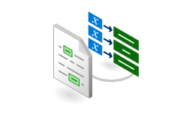
Q&A with Semantic Answering over Document Library
Embedded question
Questions
?
text-embeddings-ada-002
User
Application
Azure Open AI Service
Section 1
Embedding 1
Vector
search
Section 2
Embedding 2
Section 3
Embedding 3
N-Relevant Sections
NLP Tasks:
Summarization,
Q&A, etc.
Form Recognizer
Layout Model
text-embeddings-ada-002
Cognitive Search
text-davinci-003
Section 4
Embedding 4
Extracted Section Text
Document Library

Slide 28
Estimating the Right SKU for Your Needs Utilize a PoC Index to Calculate Your Production Requirements
Perform a PoC
Index a representative sample of your production workload using the desired schema
Sample to Production Ratio
Calculate the ratio between the sample index size and raw data source size to estimate the corresponding production index size and data source size\
Analyze and Adjust
Consider the estimated number of documents, index size, and data source size for your production workload, and add a buffer for future growth
Choose the Right SKU
Use the estimated production index size and required number of partitions and replicas to determine the appropriate Azure Cognitive Search SKU
Estimate Monthly Cost
Use the pricing calculator to estimate the SKU cost
Note: This estimation is for Azure Cognitive Search service costs only and does NOT include the cost of generating embeddings or other AI Enrichment features.

Slide 29
Getting Data into Your Search Index Comparing Push and Pull Approaches for Indexing
“Pull”
“Push”
Automated data ingestion using our Indexer
Utilize custom skills to generate embeddings and process data during indexing
Streamlined Indexing
Manual Data Ingestion giving you full control over the indexing process
Quick and easy to get started
High Flexibility

Slide 30

Introducing Integrated Vectorization End-to-end data ingestion, chunking, vectorization, and advanced retrieval
Preview
Chunking
Built-in Chunking Skill (updates to split skill) and updates to index to manage chunks vs. full documents.
Configure Chunking parameters (e.g. pages, overlap window, etc)
Automated via Indexer orchestration
Vectorization
Bring-Your-Own Azure OpenAI Endpoint
Support for other embedding model REST endpoints through custom skill
Query Vectorization capability
Preview

Slide 31
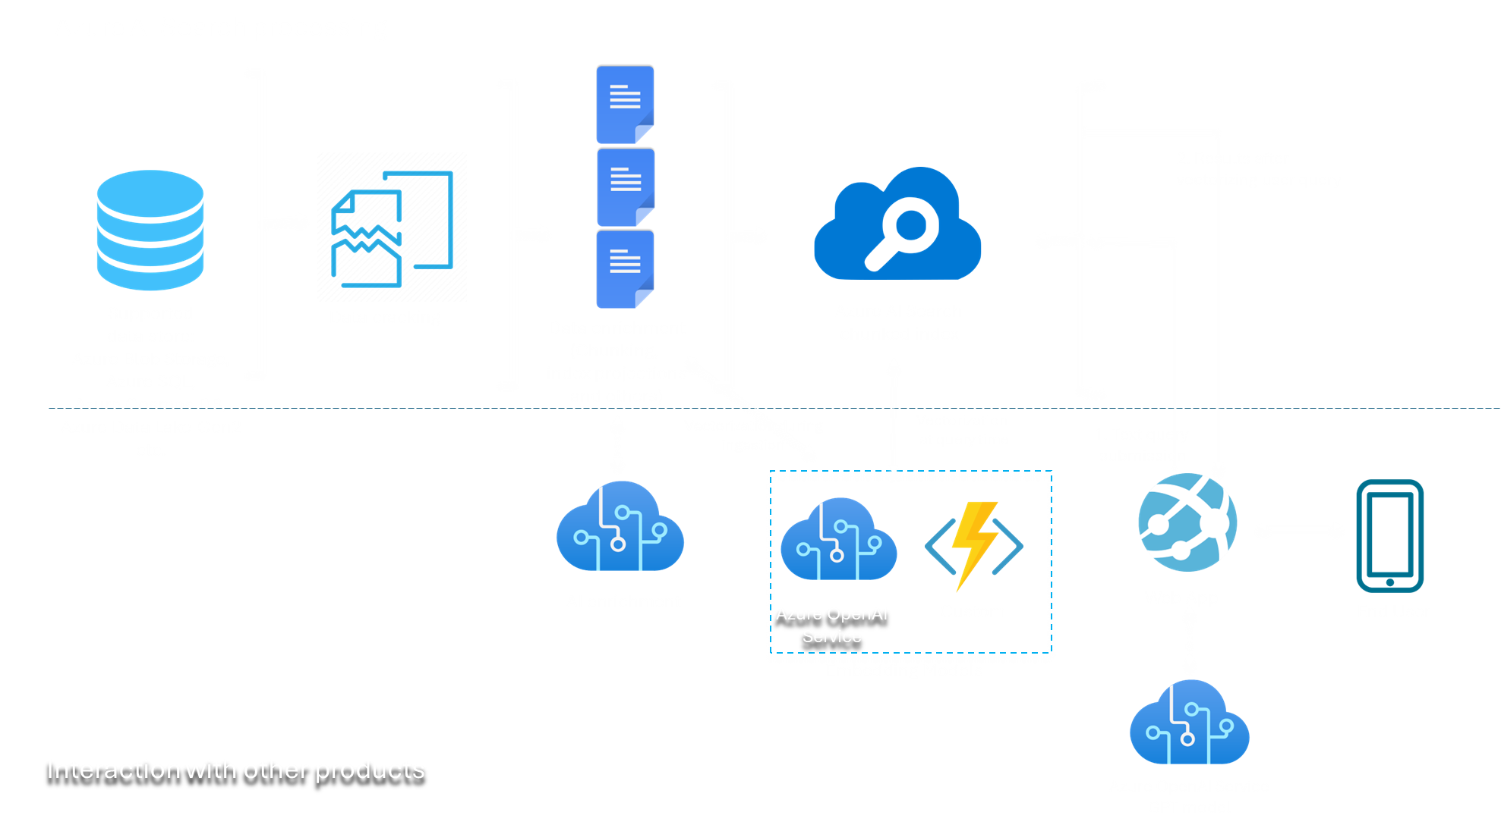
Introducing Integrated Vectorization Visualization End-to-end data ingestion, chunking, vectorization, and advanced retrieval

Slide 32










Microsoft Fabric
Data analytics for the era of AI
Data
Factory
Synapse Data
Engineering
Synapse Data
Science
Synapse Data Warehouse
Synapse Real Time Analytics
Power BI
Data Activator
OneLake
Purview

Slide 33
Microsoft Fabric
The data platform for the era of AI
From
To
One component
Single database
Isolated application
Gen AI wired in
Unified stack
All the data
Entire estate
Gen AI built in

Slide 34




1000ft view of Fabric + Azure AI integration
1
Data Pros and AI Pros access, use and process data across the AI lifecycle with OneLake as the connective tissue.
Data Pros
2
AI Pros
2
Data Pros can pre-process data and share AI-ready data to AI Pros. Once in Azure AI Studio or Azure ML, AI Pros can create LLMs, Copilot experiences and train custom ML models.
Microsoft Fabric
3
Azure AI Studio
3
AI Pros can write models and predictions to Fabric using OneLake.
Data Pros can enrich their analytics workflows in their lakehouse and warehouse or serve through Power BI using Direct Lake mode.
1
1
4
OneLake
ADLS G2 Shortcuts
4
Azure Data Lake Storage Gen 2 (ADLS G2)

Slide 35


General Available
Microsoft Fabric
Data analytics for the era of AI

Slide 36

Microsoft Fabric
GA and more
Generally Available
Public Preview
Private Preview
OneLake
Data Factory
Synapse Data Engineering
Synapse Data Science
Synapse Data Warehousing
Synapse Real Time analytics
OneLake Shortcut: ADLS2; AWS-S3; DV
Fabric SKU 1Y RI (F-SKU)​
Copilot in Microsoft Fabric**
Data Activator​
Snowflake Mirroring
Azure SQL Mirroring
Azure Cosmos DB Mirroring
Power BI

Slide 37
Microsoft Fabric
GA and more
Generally Available
Public Preview
Private Preview
Purview Integration for Sensitivity Labels
Purview integration audit log capture
Direct Lake mode support for Power BI semantic models on Fabric Warehouse
Purview integration Fabric artifacts into Purview catalog
Native integration with Power Apps for D365 and Power Plat data
Stored credentials for Direct lake semantics models
OneLake integration for import-mode semantic models using large semantic model storage
New “Explore” feature for semantic models

Slide 38
Microsoft Fabric
Data analytics for the era of AI
Complete Analytics Platform
Lake Centric and Open
Empower Every Business User
AI Powered
Everything, unified
OneLake
Familiar and intuitive
Copilot accelerated
SaaS-ified
One copy
Built into Microsoft 365
Gen AI on your data
Secured and governed
Open at every tier
Insight to action
AI-driven insights

Slide 39
Microsoft Fabric
Data analytics for the era of AI
Complete Analytics Platform
Empower Every Business User
AI Powered
Complete Analytics Platform
Lake Centric and Open
Everything, unified
Everything, unified
OneLake
Familiar and intuitive
Copilot accelerated
SaaS-ified
SaaS-ified
One copy
Built into Microsoft 365
Gen AI on your data
Secured and governed
Secured and governed
Open at every tier
Insight to action
AI-driven insights

Slide 40
Microsoft Fabric
Single…
Data
Factory
Synapse Data
Engineering
Synapse Data
Science
Synapse Data Warehouse
Synapse Real Time Analytics
Data Activator
Onboarding and trials
Sign-on
Navigation model
UX model
Workspace organization
Collaboration experience
Data Lake
Storage format
Data copy for all engines
Security model
CI/CD
Monitoring hub
Data Hub
Governance & compliance
Power BI
AI Assisted
Shared Workspaces
Universal Compute Capacities
One Security
OneLake
Intelligent data foundation

Slide 41
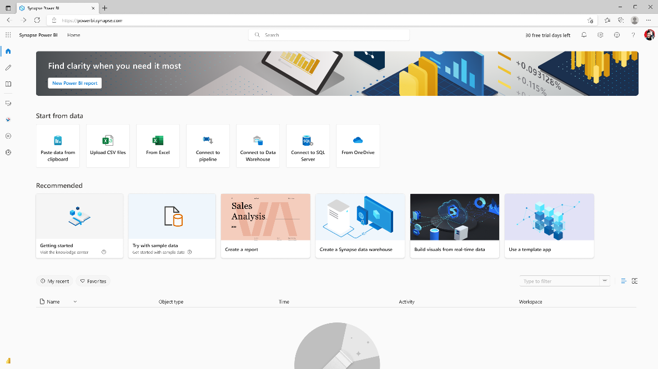
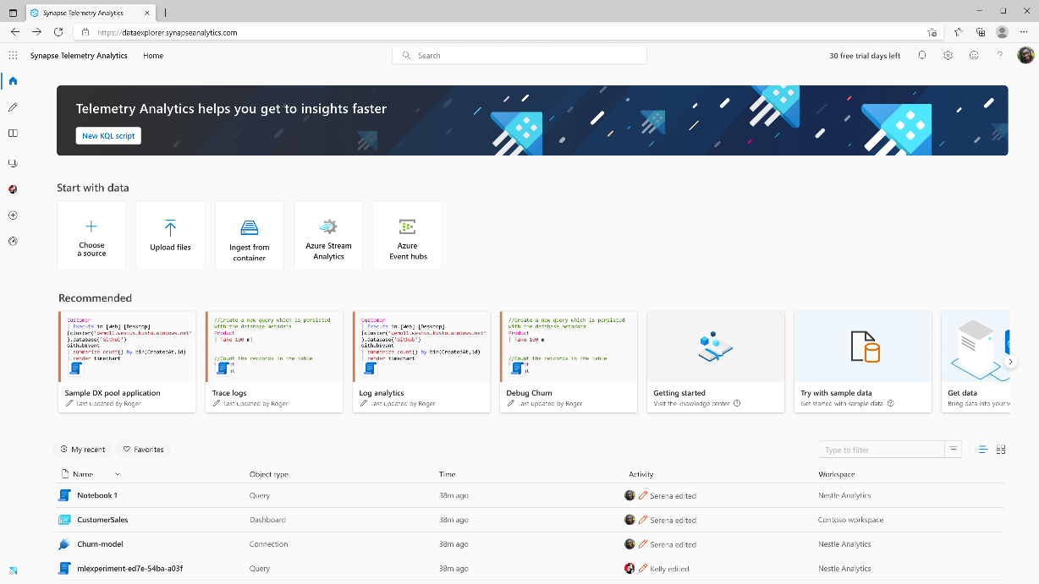
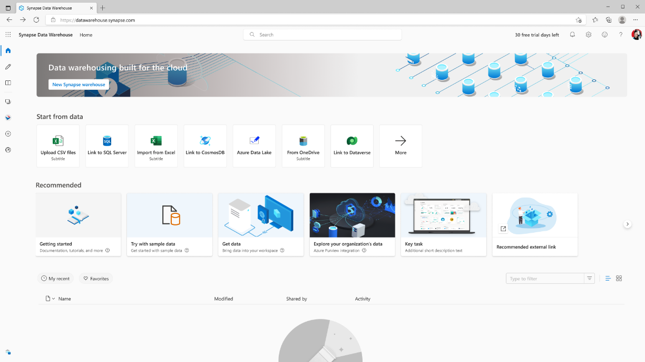
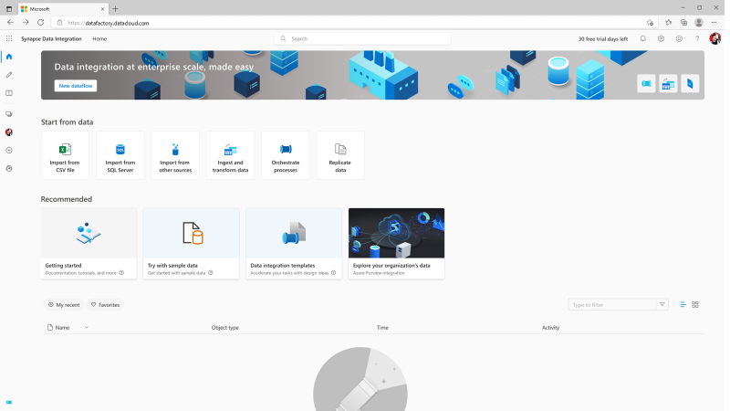
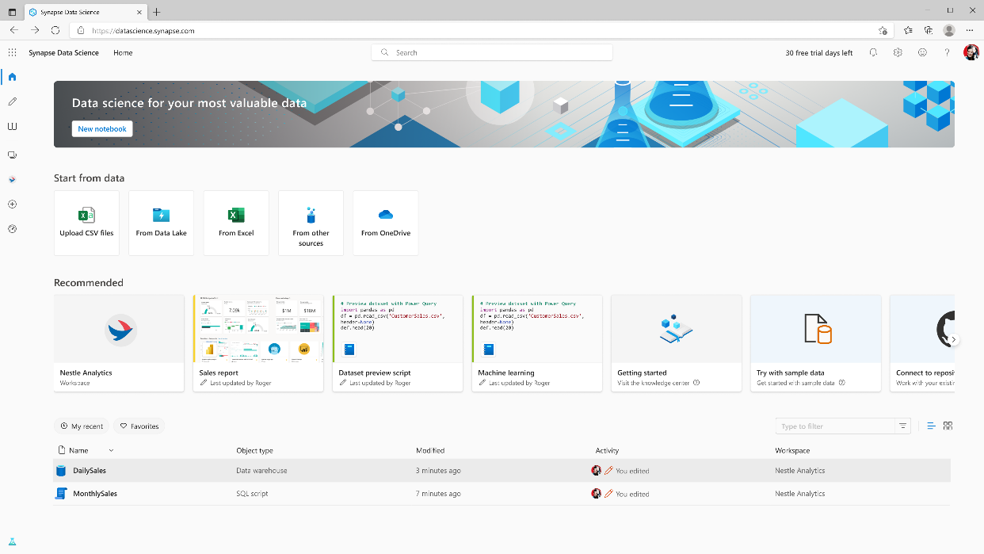
Persona optimized experiences

Slide 42
Microsoft Fabric
Data analytics for the era of AI
Complete Analytics Platform
Lake Centric and Open
Empower Every Business User
AI Powered
Lake Centric and Open
Everything, unified
OneLake
OneLake
Familiar and intuitive
Copilot accelerated
SaaS-ified
One copy
One copy
Built into Microsoft 365
Gen AI on your data
Secured and governed
Open at every tier
Open at every tier
Insight to action
AI-driven insights

Slide 43
OneLake for all Data
“The OneDrive for Data”
A single SaaS lake for the whole organization
Provisioned automatically with the tenant
All workloads automatically store their data in the OneLake workspace folders
All the data is organized in an intuitive hierarchical namespace
The data in OneLake is automatically indexed for discovery, MIP labels, lineage, PII scans, sharing, governance and compliance
Data
Factory
Synapse Data
Engineering
Synapse Data
Science
Synapse Data Warehouse
Synapse Real Time Analytics
Data Activator
Power BI
OneLake
Intelligent data foundation

Slide 44
One Copy for all computes
Real separation of compute and storage
All the compute engines store their data automatically in OneLake
The data is stored in a single common format
Delta – Parquet, an open standards format, is the storage format for all tabular data in Analytics vNext
Once data is stored in the lake, it is directly accessible by all the engines without needing any import/export
All the compute engines have been fully optimized to work with Delta Parquet as their native format
Shared universal security model is enforced across all the engines
Synapse Data
Science
Synapse Data
Engineering
Synapse Data
Science
Synapse Data
Engineering
Synapse Real Time Analytics
Synapse Data Warehouse
Synapse Real Time Analytics
Data
Factory
Synapse Data Warehouse
Data
Factory
Data Activator
Power BI
Data Activator
Power BI
Serverless
Compute
Spark
T-SQL
KQL
Analysis Services
OneLake
Customers 360
Finance
Service Telemetry
Business KPIs
Delta – Parquet Format
Delta – Parquet Format
Delta – Parquet Format
Delta – Parquet Format

Slide 45
Better together through OneLake
Open and Governed Lakehouse
All Fabric engines have been redesigned and optimized for delta/parquet as their storage format for tabular data
Azure Databricks can directly read/write data from any Fabric data item stored in OneLake through external link.
Existing non-Unity Catalog managed data in ADLS gen2 storage can be a shortcut into OneLake.
Any Fabric engine including Power BI with direct lake in OneLake or with shortcut.
Coming soon: Unity Catalog and Fabric integration, Unity Catalog data will be available through Azure Databricks data item enhanced shortcuts experience.
Microsoft Fabric
Azure Databricks

Slide 46





Unifying data in OneLake
Shortcuts
Sharing data in OneLake is as easy as sharing files in OneDrive, removing the needs for data duplication
With shortcuts, data throughout OneLake can be composed together without any data movement
Shortcuts also allow instant linking of data already existing in Azure and in other clouds, without any data duplication and movement, making OneLake the first multi-cloud data lake
With support for industry standard APIs, OneLake data can be directly accessed by any application or service
Data
Factory
Synapse Data
Engineering
Synapse Data
Science
Synapse Data Warehouse
Synapse Real Time Analytics
Data Activator
Power BI
OneLake
Customers 360
Finance
Service Telemetry
Business KPIs
Azure Storage
Databricks
Amazon S3
Google
Dataverse

Slide 47








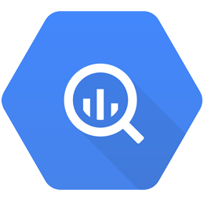
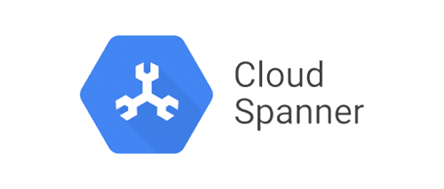




Unifying data in OneLake
Frictionless Linking of External Databases
Data
Factory
Synapse Data
Engineering
Synapse Data
Science
Synapse Data Warehouse
Synapse Real Time Analytics
Power BI
Data Activator
OneLake
Azure
Amazon
Google

Slide 48
Private Preview
Mirroring in Fabric
Near real-time replication of proprietary database stores with zero-ETL
TDS
(Data Plane)
XMLA
(Data Plane)
Delta
(Data Plane)
Mirrored Database
Fabric DW
Power
BI
Fabric
Spark
Cosmos DB, SQL DB,
Snowflake, ++
Proprietary Store
Consumption Replica
CDC
Replicator
High throughput, low latency
Delta Parquet in OneLake

Slide 49
Microsoft Fabric
Data analytics for the era of AI
Empower Every Business User
Complete Analytics Platform
Lake Centric and Open
Empower Every Business User
AI Powered
Everything, unified
OneLake
Familiar and intuitive
Familiar and intuitive
Copilot accelerated
SaaS-ified
One copy
Built into Microsoft 365
Built into Microsoft 365
Gen AI on your data
Secured and governed
Open at every tier
Insight to action
Insight to action
AI-driven insights

Slide 50
Microsoft Fabric
Data analytics for the era of AI
Empower Every Business User
AI Powered
Complete Analytics Platform
Lake Centric and Open
AI Powered
Everything, unified
OneLake
Familiar and intuitive
Copilot accelerated
Copilot accelerated
SaaS-ified
One copy
Built into Microsoft 365
Gen AI on your data
Gen AI on your data
Secured and governed
Open at every tier
Insight to action
AI-driven insights
AI-driven insights

Slide 51

Copilot in Microsoft Fabric
Private Preview
Generative AI for every step of your data journey
Unlock Your Data
Enhance Productivity
Accelerate Insight Discovery
Intelligent data prep and integration for every data source
Harness the power of AI to turn your ideas into solutions
Analyze and explore your data faster

Slide 52








Customer Momentum

Slide 53
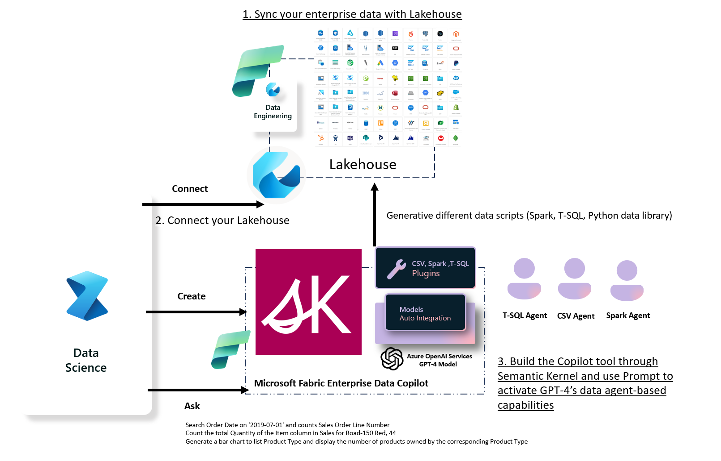
Chat your data in Microsoft Fabric with Semantic Kernel
Use Semantic Kernel with Lakehouse in Microsoft Fabric | Microsoft Fabric Blog | Microsoft Fabric
Chat your data in Microsoft Fabric with Semantic Kernel | Microsoft Fabric Blog | Microsoft Fabric

Slide 54

Cosmos DB
+

Slide 55
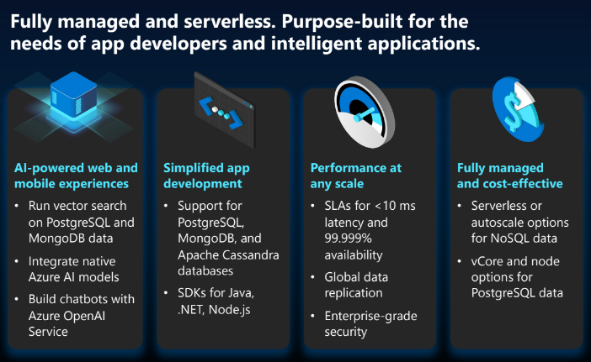
What is Cosmos DB?

Slide 56
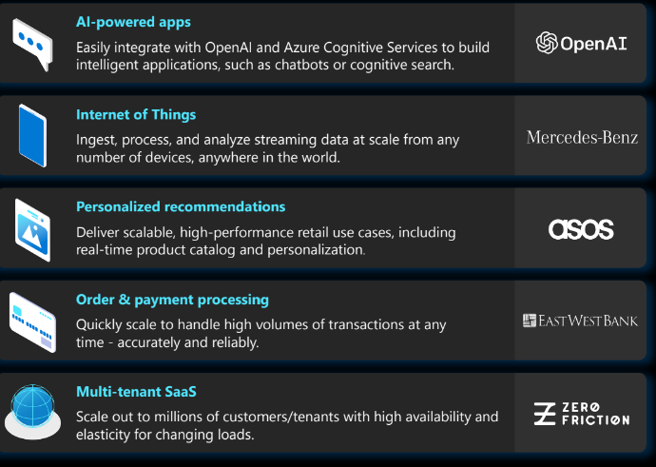
Cosmos DB Use Case

Slide 57

What is Azure Cosmos DB for MongoDB?
Azure Cosmos DB for MongoDB makes it easy to use Azure Cosmos DB as if it were a MongoDB database. You can use your existing MongoDB skills and continue to use your favorite MongoDB drivers, SDKs, and tools by pointing your application to the connection string for your account using the API for MongoDB.
Request Unit (RU)based and vCore-based
Introduction/Overview - Azure Cosmos DB for MongoDB | Microsoft Learn

Slide 58
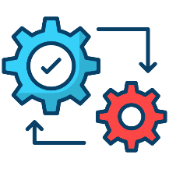



Azure Cosmos DB for MongoDB vCore
Effortless Integration with Azure Platform
Seamless resource management with familiar tools
Boost efficiency with deep integration into Azure products
Enjoy peace of mind with one support team for all services
Flexibility for Developers
No shard key required until database surpasses TBs
Pricing based on vCPUs and disks
No limit on number of collections in DB
Choose the architecture that works best for your workload
A Fast Solution That Simply Works
Effortlessly transition with a simple lift and shift
TCO- Architecture performance- we pass the savings to you
Architecture and features match expectations
Native support for vector similarity search
Find the most relevant documents using OpenAI embeddings
Store vectors and data in one place
Scale to scenarios with millions of vectors
Unlock the full potential of the Azure ecosystem with a MongoDB compatible database that simply works.
A new architecture designed to provide seamless integration and unbeatable performance

Slide 59
RAG & Cosmos DB
Retrieval Augmented Generation (RAG) is a method that combines the strengths of LLMs and information retrieval systems. It uses a two-step process:
Retrieve relevant documents from a large corpus based on the input prompt
Generate a response using the retrieved documents as context for an LLM
This allows the model to pull in real-time information, making your AI-powered applications more dynamic and personalized to your scenarios.
We can implement patterns for RAG leveraging vector search in Cosmos DB for MongoDB vCore.

Slide 60

The end to end flow Convert data into vector representations where distances represent similarity
Data Sources
Vector Representation
Approximate Nearest Neighbor
Vector Representation
App/UX
Images
-2, -1 , 0, 1
Audio
Azure Cognitive Search
Transform into embeddings
2, 3, 4, 5
2, 3, 4, 5
Transform into embedding
6, 7, 8, 9
Video
Text
Results
...and more!

Slide 61
Why use vector embeddings?
Our focus
Generative AI
Chatbots, Text Gen. Image/video Gen.
Search
Text, Documents, Images, Videos, Objects
Reco Systems
Content Items, User Profiles, Personalization
Anomaly Detection
Monitoring, Errors, Fraud
MLOps
Data shift, training, labeling
Data Preparation
Tagging, Cleaning, EDA

Slide 62
Simple RAG pattern w/ Cosmos DB for MongoDB vCore
Load data
Generate document embeddings
Store in database/collection
Create a vector index
Generate query embedding
Perform vector search
Ground model with resulting documents

Slide 63
Define a vector index Azure Cosmos DB for MongoDB vCore
{
"createIndexes": "<collection_name>",
"indexes": [
{
"name": "<index_name>",
"key": {
"<path_to_property>": "cosmosSearch"
},
"cosmosSearchOptions": {
"kind": "vector-ivf",
"numLists": <integer_value>,
"similarity": "<string_value>",
"dimensions": <integer_value>
}
}
]
}

Slide 64
Perform a vector search Azure Cosmos DB for MongoDB vCore
{$search: {index:<vector_index_name>, cosmosSearch: { "vector": <query_vector>,
"path": "<path_to_property>",
"k": <num_results_to_return>}, returnStoredSource:true}}, {$project: { rank: { $meta: 'searchScore' }, document : '$$ROOT' } }

Slide 65
Demos
Notebook using RAG with Azure Cosmos DB for MongoDB vCore
AI assistant web app in Azure

Slide 66
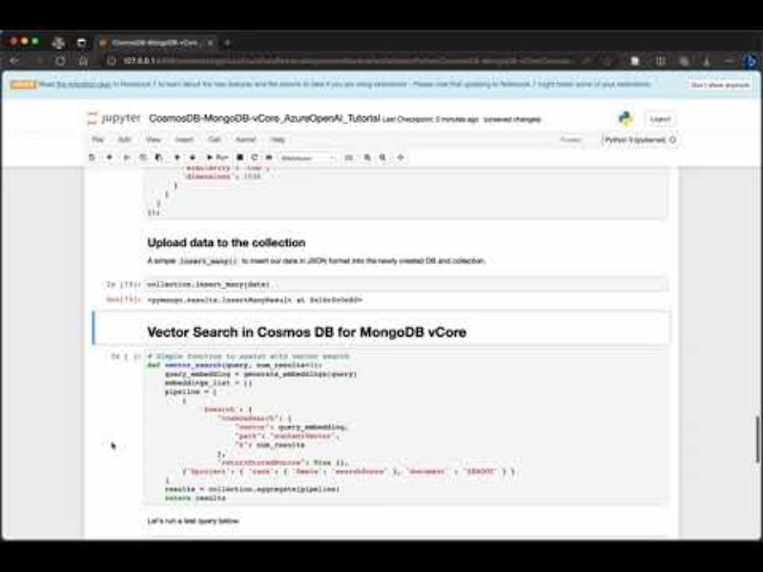
RAG Demo Azure Cosmos DB for MongoDB vCore
microsoft/AzureDataRetrievalAugmentedGenerationSamples: Samples to demonstrate pathways for Retrieval Augmented Generation (RAG) for Azure Data (github.com)

Slide 67
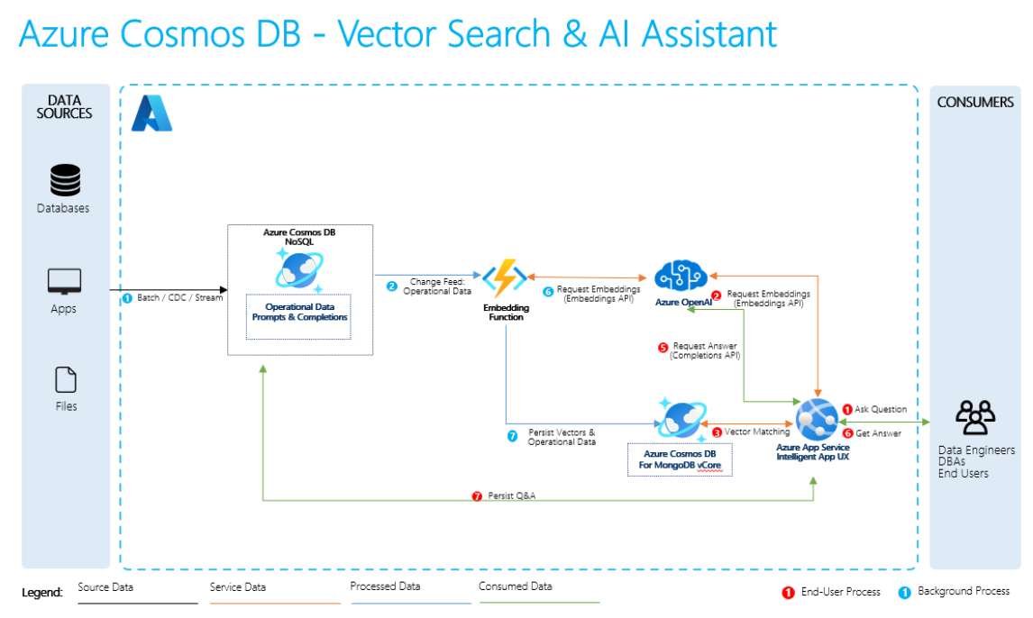
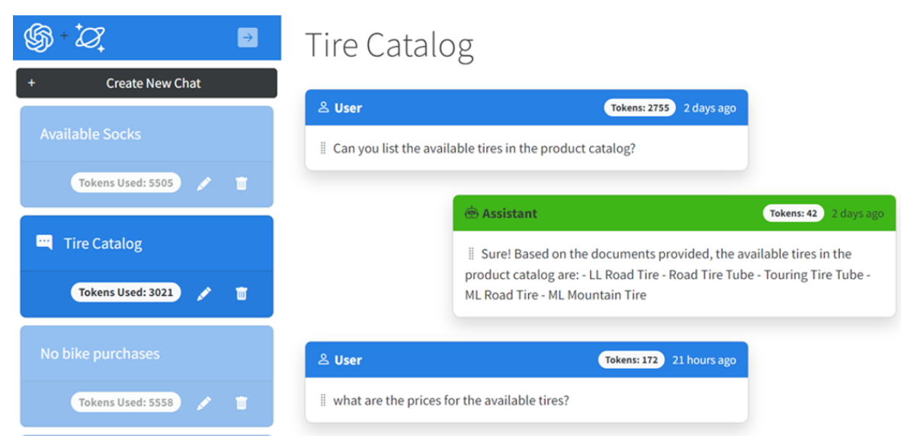
Sample Architecture & Demo
http://Aka.ms/mongo-vector-sample

Slide 68
Solution Component
This solution is composed of the following services:
Azure Cosmos DB - Stores the operational retail data, chat prompts and completions.
Azure Cosmos DB for MongoDB vCore - stores the vectorized retail data for search.
Azure Functions - Hosts a Cosmos DB trigger to generate embeddings and Azure Cosmos DB for MongoDB vCore to save the vectors.
Azure OpenAI - Generates embeddings using the Embeddings API and chat completions using the Completion API.
Azure App Service - Hosts Intelligent Agent UX.

Slide 69
Resources
Introducing Vector Search in Azure Cosmos DB for MongoDB vCore - Azure Cosmos DB Blog (microsoft.com)
Vector - Azure Cosmos DB for MongoDB vCore | Microsoft Learn
Build AI apps with vector search - Azure Cosmos DB for MongoDB vCore | Microsoft Learn
microsoft/AzureDataRetrievalAugmentedGenerationSamples: Samples to demonstrate pathways for Retrieval Augmented Generation (RAG) for Azure Data (github.com)
https://github.com/Azure/Vector-Search-Ai-Assistant/tree/mongovcorev2
Build next gen intelligent retail with Azure OpenAI & Azure Cosmos DB

Slide 70
Retrieval Augmented Generation
Loading Data into Cosmos DB
- The first step involves collecting and organizing relevant data into a database like Cosmos DB. This data could be a knowledge base consisting of text documents, articles, or any other structured or semi-structured information.
- Cosmos DB is used to efficiently store and manage this data, making it accessible for retrieval.
Creating Embeddings from Relevant Data
- Once the data is in Cosmos DB, the next step is to create embeddings for this data. Embeddings are numerical representations of the content that capture the semantic meaning of the text.
- Techniques like word embeddings (e.g., Word2Vec, GloVe) or more advanced methods like BERT embeddings can be used to convert the textual data into numerical vectors.
Creating Vector Embeddings from User Queries
- When a user submits a query or question, the query text is also converted into a vector embedding using the same embedding techniques. This step ensures that both the query and the data in Cosmos DB are in a compatible numerical format for comparison.
Performing Vector Search on the Query Embedding
- Using the vector embeddings created in step 2 and step 3, a vector search is performed. This is often done using similarity metrics like cosine similarity.
- The search identifies the data items (documents or knowledge snippets) in Cosmos DB that are most similar to the user's query based on their vector embeddings. These retrieved documents contain potentially relevant information.
Grounding the LLM with the Vector Search Results
- The final step involves taking the top results from the vector search and presenting them to the LLM. The LLM can now use these retrieved documents as context to generate a response to the user's query.
- By grounding the LLM with the vector search results, it can generate more contextually relevant and informed responses by incorporating information from the retrieved documents.

Slide 71
RAG w/ Cosmos DB for MongoDB vCore
Create vectors using Azure OpenAI Embeddings API and store them in your documents in Azure Cosmos DB for MongoDB vCore
Store long term memory and chat history to improve your Large Language Model (LLM) solution
Efficiently query back the most relevant context to personalize Azure OpenAI Service prompts in a token-efficient manner
Minimize data synchronization management and accelerate time-to-market for AI app development

Slide 72
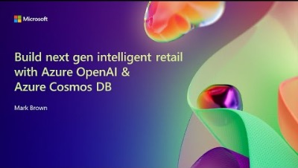
AI Assistant Demo
Video: Build next gen intelligent retail with Azure OpenAI & Azure Cosmos DB
GitHub: https://github.com/Azure/Vector-Search-AI-Assistant-MongoDBvCore

Slide 73
Azure OpenAI
Function Call

Slide 74
Azure OpenAI Function Call
Function calling is now available in Azure OpenAI Service and gives the latest 0613 versions of gpt-35-turbo and gpt-4 the ability to produce structured JSON outputs based on functions that you describe in the request.
Why AOAI function call?
This provides a native way for these models to formulate API calls and structure data outputs, all based on the functions you specify. It's important to note that while the models can generate these calls, it's up to you to execute them, ensuring you remain in control.
Public Preview

Slide 75
How function calling works
The latest versions of gpt-35-turbo and gpt-4 have been fine-tuned to learn how to work with functions. If one or more functions are specified in the request, the model will then determine if any of the functions should be called based on the context of the prompt. When the model determines that a function should be called, it will then respond with a JSON object including the arguments for the function.
Step #1 – Call the chat completions API with your functions and the user’s input
Step #2 – Use the model’s response to call your API or function
Step #3 – Call the chat completions API again, including the response from your function to get a final response

Slide 76
Use case for function call
Retrieve data from data sources or APIs
Integrating with APIs or tools
Creating structured outputs
Function calling is now available in Azure OpenAI Service - Microsoft Community Hub

Slide 77
Tips on using functions safely and securely
Validate Function Calls: Always verify the function calls generated by the model. This includes checking the parameters, the function being called, and ensuring that the call aligns with the intended action.
Use Trusted Data and Tools: Only use data from trusted and verified sources. Untrusted data in a function’s output could be used to instruct the model to write function calls in a way other than you intended.
Follow the Principle of Least Privilege: Grant only the minimum access necessary for the function to perform its job. This reduces the potential impact if a function is misused or exploited. For example, if you’re using function calls to query a database, you should only give your application read-only access to the database. You also shouldn’t depend solely on excluding capabilities in the function definition as a security control.
Consider Real-World Impact: Be aware of the real-world impact of function calls that you plan to execute, especially those that trigger actions such as executing code, updating databases, or sending notifications.
Implement User Confirmation Steps: Particularly for functions that take actions, we recommend including a step where the user confirms the action before it's executed.

Slide 78
Reference Link
How to use function calling with Azure OpenAI Service - Azure OpenAI Service | Microsoft Learn
azure-docs/articles/ai-services/openai/how-to/function-calling.md at main · MicrosoftDocs/azure-docs · GitHub

Slide 79

The OpenAI Whisper Model in Azure OpenAI Service and Azure AI Speech

Slide 80

Introduction
OpenAI released an optimized version of the Whisper large-v2 model as an API on March 1st.
This presentation provides information on the OpenAI Whisper Model (referred to as the “Whisper Model” in this deck) as an API in the Azure OpenAI Service and as a model in the Azure AI Speech services.
It also provides guidance on how to choose between Azure AI Speech models and the OpenAI Whisper Model for a given customer use case.
Public preview as of Sep 2023

Slide 81
Overview of the OpenAI Whisper Model
Whisper is an encoder-decoder Transformer from OpenAI that processes 30 second chunks of audio and converts them into text in multiple languages whilst also providing translation of the text from those languages to English (i.e. the output of the translation is English only).
OpenAI provides two simple REST APIs to use the Whisper model.
Transcribe
Translate
Is single model that recognizes up to 57 languages
Does fast, single file synchronous processing
Has output of the display in formatted text
Provides direct output to SRT and VTT video captioning files
Supports runtime customization through prompt

Slide 82
Regional data processing Developers control in which specific data center processing occurs for compliance with data protection regulations.
Reliability and Business Continuity Azure AI Speech SLA: 99.9%. Business Continuity and Disaster Recovery through failover across Azure datacenters.
Security Azure security plus support for VNet/private link, Role based access and Bring your own storage.
Privacy Azure OpenAI Service and Azure AI Speech do not log or store customer data or use it to improve our general speech models.
Compliance ISO, HIPAA, SOC and a broad range of other certifications.
Deployment flexibility Azure AI Speech models: Cloud, containers and embedded speech recognition on devices.
Support Support, up to 24x7 and <15min response time provided by Azure support.
The Whisper Model in Azure supports Enterprise Readiness

Slide 83


Better readability
Better identification of sentence boundaries, punctuation, capitalization of words, formatting of numbers based on context (example “Albany Development Code 9.208(2)”), removal of disfluencies and repetitions found in human conversations
Whisper Model Capabilities
Multi-language support
Automatically recognizes the language spoken. Mixed-language recognition Supports direct translation to English.
Fast transcription
No streaming audio input, but recognition of a file is quite fast. Realtime Factor (RTF) of up to 20x: 10-minute audio clip processed in 30 seconds
Runtime customization
Improve accuracy and influence the output generated through natural language prompts.

Slide 84
Using the Whisper Model in Azure
There are multiple ways customers can use the Whisper Model on Azure:
Via Azure AI Speech – enables customers to use the Whisper Model with the Azure AI Speech batch transcription API
Via the Azure OpenAI Service – mirrors the OpenAI API and its functionality

Slide 85
Using the Whisper Model in Azure
There are multiple ways customers can use the Whisper Model on Azure:
Via Azure AI Speech – enables customers to use the Whisper Model with the Azure AI Speech batch transcription API
Via the Azure OpenAI Service – mirrors the OpenAI API and its functionality
Via Azure ML – through the Hugging Face model catalog. This is the Whisper open-source model that is part of the general open-source model catalog available in Azure ML.
The deck is going to focus on the first two ways and the following slides are going to detail these further.

Slide 86
The Whisper Model in Azure AI Speech and on Azure OpenAI Service
Azure AI Speech
Azure OpenAI
1
2
3
The Whisper Model
Readability is important: punctuation, formatting, sentence flow
Azure AI Speech Models
Azure OpenAI Models
Whisper Model on Azure AI Speech
(provide addl. capabilities)
Whisper Model on Azure OpenAI (mirror OpenAI API)
Mixed language audio transcription
Offline captioning (i.e. not real time)

Slide 87
Azure AI Speech This section provides a brief overview to the capabilities of Azure AI Speech
1

Slide 88


Azure AI Speech overview
Speech Capabilities to Enhance your Applications
Speech to Text including the OpenAI Whisper Model | Text to Speech | Speech Translation | Speaker Recognition
Azure Tools To help you Customize and Integrate
Speech Studio | Ingestion Client | Batch Toolkit | Speech SDK
Flexible Deployment Options
Cloud, On-Prem, On Edge

Slide 89
Azure AI Speech Capabilities
Broad set of Speech technologies
Speech technologies beyond Speech Transcription and Translation: Neural Text-to-Speech, Speaker Recognition, Keyword Spotting and Pronunciation Assessment.
Rich Set of features
Richer metadata with the recognition results. Speaker Diarization.
Broad range of languages with high accuracy
Most languages of any provider: 76 languages across 140 languages/locales (Whisper: 57 languages).
Comprehensive Customization Capabilities
Runtime customization through PhraseList.
Comprehensive offline customization through Custom Speech.
Language ID and Translation
Continuous identification of language changes among up to 10 languages. Speech Translation API combines Speech + Machine Translation for a wide range of languages.
Batch processing of large amounts of data
Azure AI Speech provides the ability to process audio at scale either in real-time or through batch processing. Proven large scale audio processing for both real-time and batch.

Slide 90
Azure OpenAI Service This section provides a brief overview to the capabilities of Azure OpenAI Service
2

Slide 91


Ensure that artificial general intelligence (AGI) benefits humanity.
Empower every person and organization on the planet to achieve more
GPT-4
GPT-3
ChatGPT
Codex
DALL·E
Generative Text Models, with varying capabilities and uses
Specialized Generative
Coding Model
Generative Image Model
On your own data
Provisioned throughput model
Plugins for Azure OpenAI Service

Slide 92




Azure OpenAI Service Capabilities
Content Generation
Automatic content generation, from personalized replies to callers to developing a personalized UI for your website
Summarization
Summary of call logs, document summarization
Code Generation
Code Documentation
Code conversion
Semantic Search
Information Discovery and Knowledge Mining, Search through reviews
Within the customer’s Azure subscription
Deployed within your Azure subscription, secured by you, accessed only by you, and tied to your datasets and applications
Built in Response AI features
Built-in responsible AI to detect and flag harmful use

Slide 93
The Whisper Model in Azure – Guidance The section aims to provide a guide for when to use the Whisper model, and whether to use it via the Azure OpenAI Service or Azure AI Speech.
3

Slide 94


Evaluate the Whisper Model against other models in Azure AI Speech to choose what works best for each scenario
The section is organized in the following 2 sub-sections:
Is the Whisper Model a good choice for my scenario, or is an Azure AI Speech model better? What are the API comparisons between the two types of models?
If I want to use the Whisper Model, should I use it via the Azure OpenAI Service or via Azure AI Speech? What are the scenarios that guide me to use one or the other?

Slide 95
Azure AI Speech – Whisper Model or Speech Model?
Within Azure AI Speech, one can choose whether they want to use the Whisper Model or the Azure AI Speech model. And the decision comes down to the scenario in question. Typical guidance is as follows:
Whisper Model
Captioning, where readability by humans is important
Speech Model
Real-time streaming audio speech to text processing (e.g. live captioning or in agent assist)
Mixed language audio.
Single language transcription and translation where Azure AI Speech models are more accurate (e.g. tail languages, telephony audio).

Slide 96
API comparison
API Type | Description | Azure AI Speech models | Whisper model | Choice
Realtime streaming | Audio continuously streamed to service Processed as audio comes in Provides intermediate (word by word) results and final (utterance level) results with minimal lag | SDK (Websocket) | n/a |  | Azure AI Speech Model
Synchronous single audio | Single audio is in the request payload Process as fast as possible Limited to <15-30 minutes of audio depending on audio compression | REST Sync API | REST Sync API |  | Whisper Model
Asynchronous bulk file processing | Audio files in online storage Process many files in parallel Can handle very long files (hours of audio) | Batch Async API | Batch Async API |  | Azure AI Speech Model

Slide 97
Whisper Model – Via Azure AI Speech or Via Azure OpenAI Service?
One can choose whether to use the Whisper Model via Azure OpenAI or via Azure AI Speech. And the decision comes down to the scenario in question. Typical guidance is as follows:
Via Azure OpenAI Service
Customers who are looking for a simple API to transcribe captured audio files
Via Azure AI Speech
Customers who need additional functionality:
Customers who need to translate audio to English
Diarization
Word-level timestamps
Customization of Whisper using Custom Speech (coming soon)
Transcribe files larger than 25MB (up to 1GB)
Process large batches of audio files
Supported file formats: mp3, mp4, mpweg, mpga, m4a, wav and webm.
Supported file formats: mp3, wav and ogg.

Slide 98
The Whisper Model in Azure AI Speech and on Azure OpenAI Service
Azure AI Speech
Azure OpenAI
1
2
Text to Speech
3
The Whisper Model
GPT-4
Speech Translation
GPT-3.5
Readability is important
Whisper Model on Azure OpenAI
Speaker Recognition
Speaker Diarization, Word level time stamps
File based (i.e. not streaming)
DALL-E
Whisper Model on Azure AI Speech
Translation (to English only)
Long audios
Mixed language audio
Prompting
Batch processing
Offline captioning
Speech to Text
ChatGPT

Slide 99
Typical Customer Speech Scenarios
Scenario | Sub-scenario | Description​
Captioning Subtitling | Online & in-person mtg caption/subtitle | AI generated captions (including translated captions) of meeting conversations. Generated in real-time.​
 | Live Audio/Video caption/subtitle | AI generated captions (including translated captions) of live audio or video streams. Generated in real-time.​
 | Offline Audio/Video captioning/subtitling | AI generated captions (including translated captions) of existing audio/video recordings.​
Transcription | Contact Center – Post Call Analytics | AI generated transcript of call recordings + analytics (call summary, sentiment, key topics, custom insights)​
 | Contact Center – Agent Assist | AI generated transcript during a customer call + analytics (assist call center agents in real-time with customer questions).​
 | Meeting Transcription | AI generated transcript of meeting recordings + analytics (meeting summary, meeting chaptering, action item extraction).​
 | Audio/Video Transcription | AI generated transcript of audio/video recordings​
 | Dictation | Realtime text entry and document generation through voice dictation​
Voice Agent | Contact Center – Voice Agent | AI based call routing and interactive voice response for call centers​
 | Voice Assistant | Application specific voice assistant (set-top box, mobile app, in-car, etc.)​
Content Reader | Content Creation | AI generated audio content (news articles, audio books, etc.)​
 | Screen Reader | Assistive technology to read out screen content​
Language Learning | Teaching language/Name pronunciation | Automated feedback on pronunciation of read aloud text. Content generation for language learning.​
Speech to Speech Translation | Live Speech-to-speech translation | Real-time translation between two languages including speech output in the translated language​
Speech to Speech Translation | Batch Speech translation to English only | AI generated translated text for audio/video recordings​
 | Batch Speech translation to other languages | AI generated translated text for audio/video recordings​

Slide 100

Typical Customer Speech Scenarios – When to use what
Scenario | Sub-scenario | Whisper in Azure OpenAI Service | Azure AI Speech (Whisper Model or Azure AI Speech models)
Captioning Subtitling | Online & in-person mtg caption/subtitle | n/a | Azure AI Speech model for realtime processing
 | Live Audio/Video caption/subtitle | n/a | Azure AI Speech model for realtime processing
 | Offline Audio/Video captioning/subtitling | Fast processing of individual audio files | Batch processing, large files, diarization, word level timestamps
Transcription | Contact Center – Post Call Analytics | Fair | Use Azure AI Speech models for telephony audio
 | Contact Center – Agent Assist | n/a | Azure AI Speech model for realtime processing
 | Meeting Transcription | Good | Best
 | Audio/Video Transcription | Best | Good
 | Dictation | n/a | Azure AI Speech model for real time processing
Voice Agent | Contact Center – Voice Agent | Fair – Whisper return results for short audio quickly | Azure AI Speech model for real time processing
 | Voice Assistant | Fair – Whisper return results for short audio quickly | Azure AI Speech model for real time processing
Content Reader | Content Creation | n/a | Azure AI Speech model of text to speech
 | Screen Reader | n/a | Azure AI Speech model of text to speech
Language Learning | Teaching language/Name pronunciation | n/a | Azure AI Speech model of text to speech
Speech to Speech Translation | Live Speech-to-speech translation | n/a | Azure AI real time Speech Translation API
Speech to Speech Translation | Batch Speech translation to English only | Best | Azure AI realtime Speech Translation API
 | Batch Speech translation to other languages | n/a | Azure AI real time Speech Translation API

Slide 101
Pricing
Azure OpenAI Service - Pricing | Microsoft Azure
© 2023 Microsoft Corporation. All rights reserved

Slide 102
Next Steps The guidance for customers on next steps is to try out the various offerings within Azure AI – both with Azure AI Speech and with Azure OpenAI Service
© 2023 Microsoft Corporation. All rights reserved

Slide 103
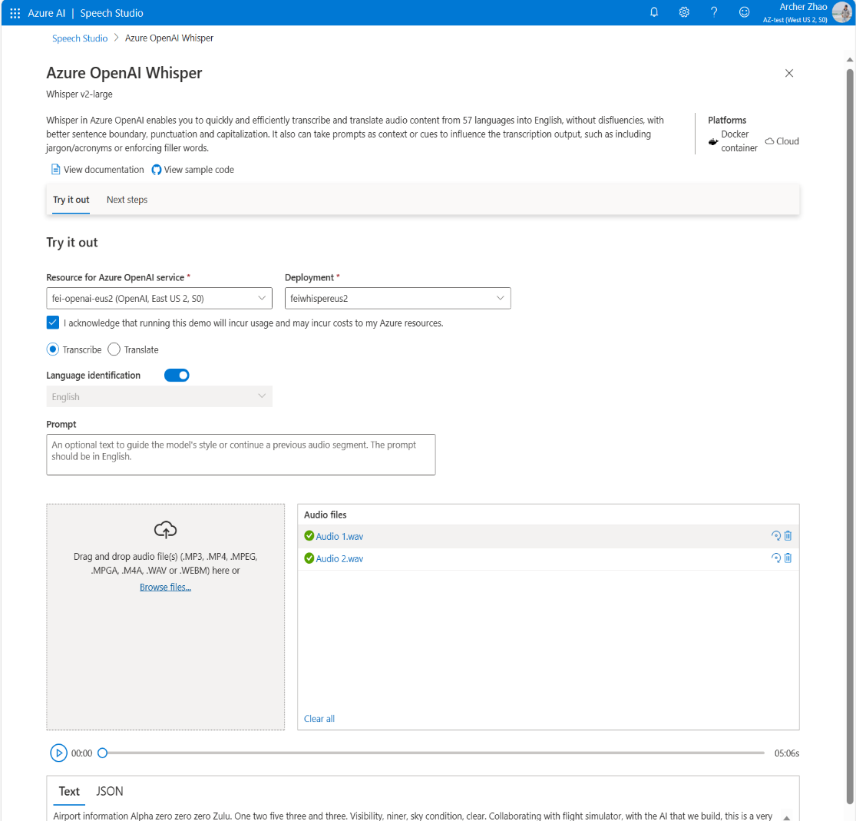
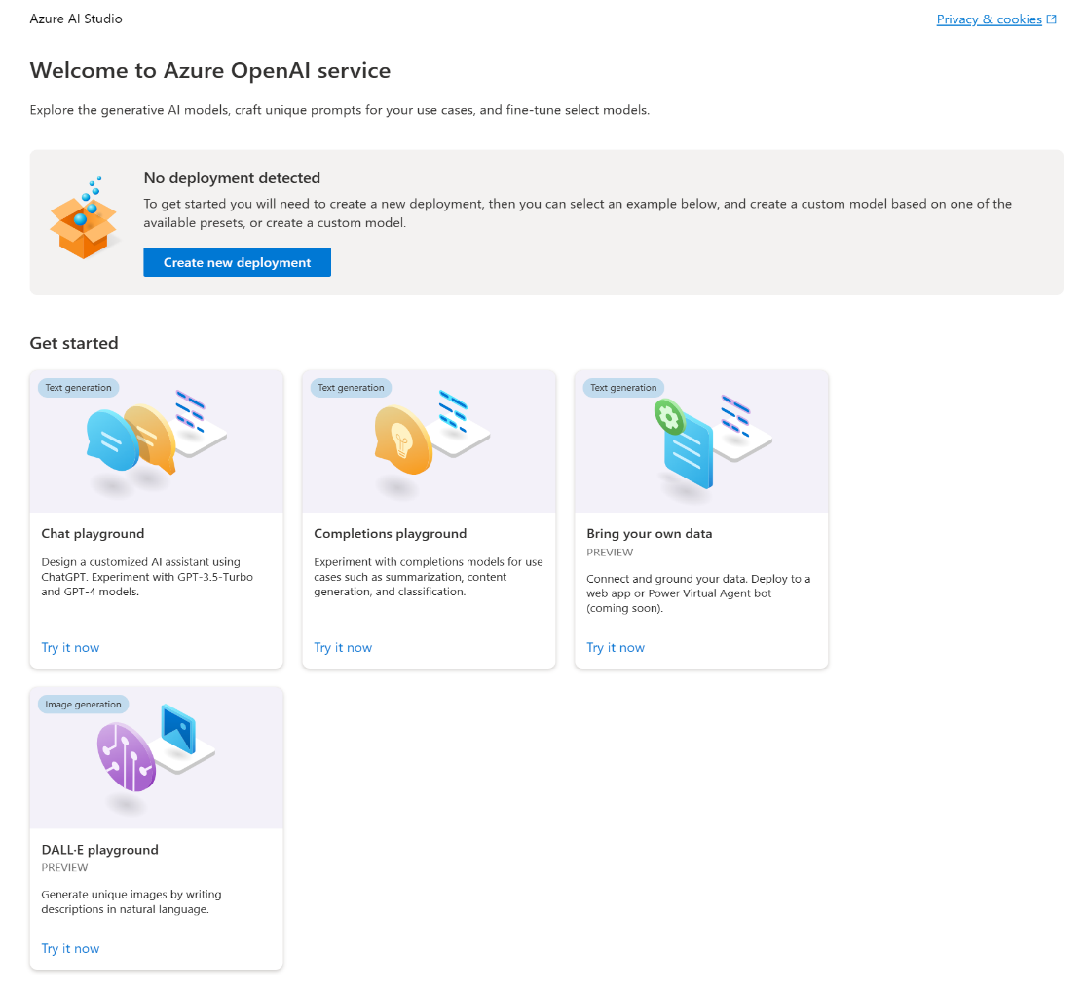
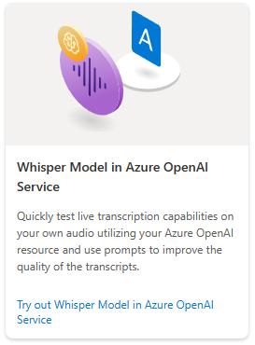
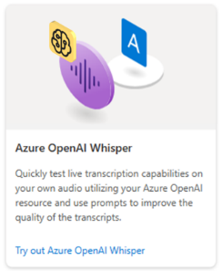
Azure AI Studio will direct users to Azure AI Speech Studio
Azure AI Studio
Azure AI Studio will host a tile directing customers to the Speech Studio for Whisper UX demos.
Whisper in Azure OpenAI Service UX Demo
Clicking on the tile will open a new tab to Whisper UX demo on Azure AI Speech Studio.

Slide 104
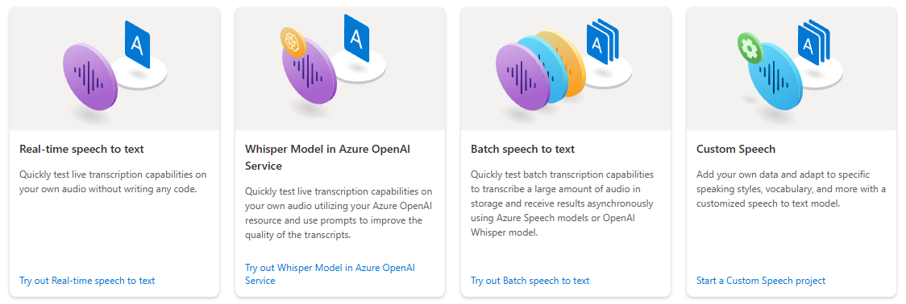
In Azure AI Speech Studio, Try out and Evaluate the Whisper Model and the Azure AI Speech models
You can try-out and evaluate Azure AI Speech and Whisper models in Azure AI Speech Studio

Slide 105
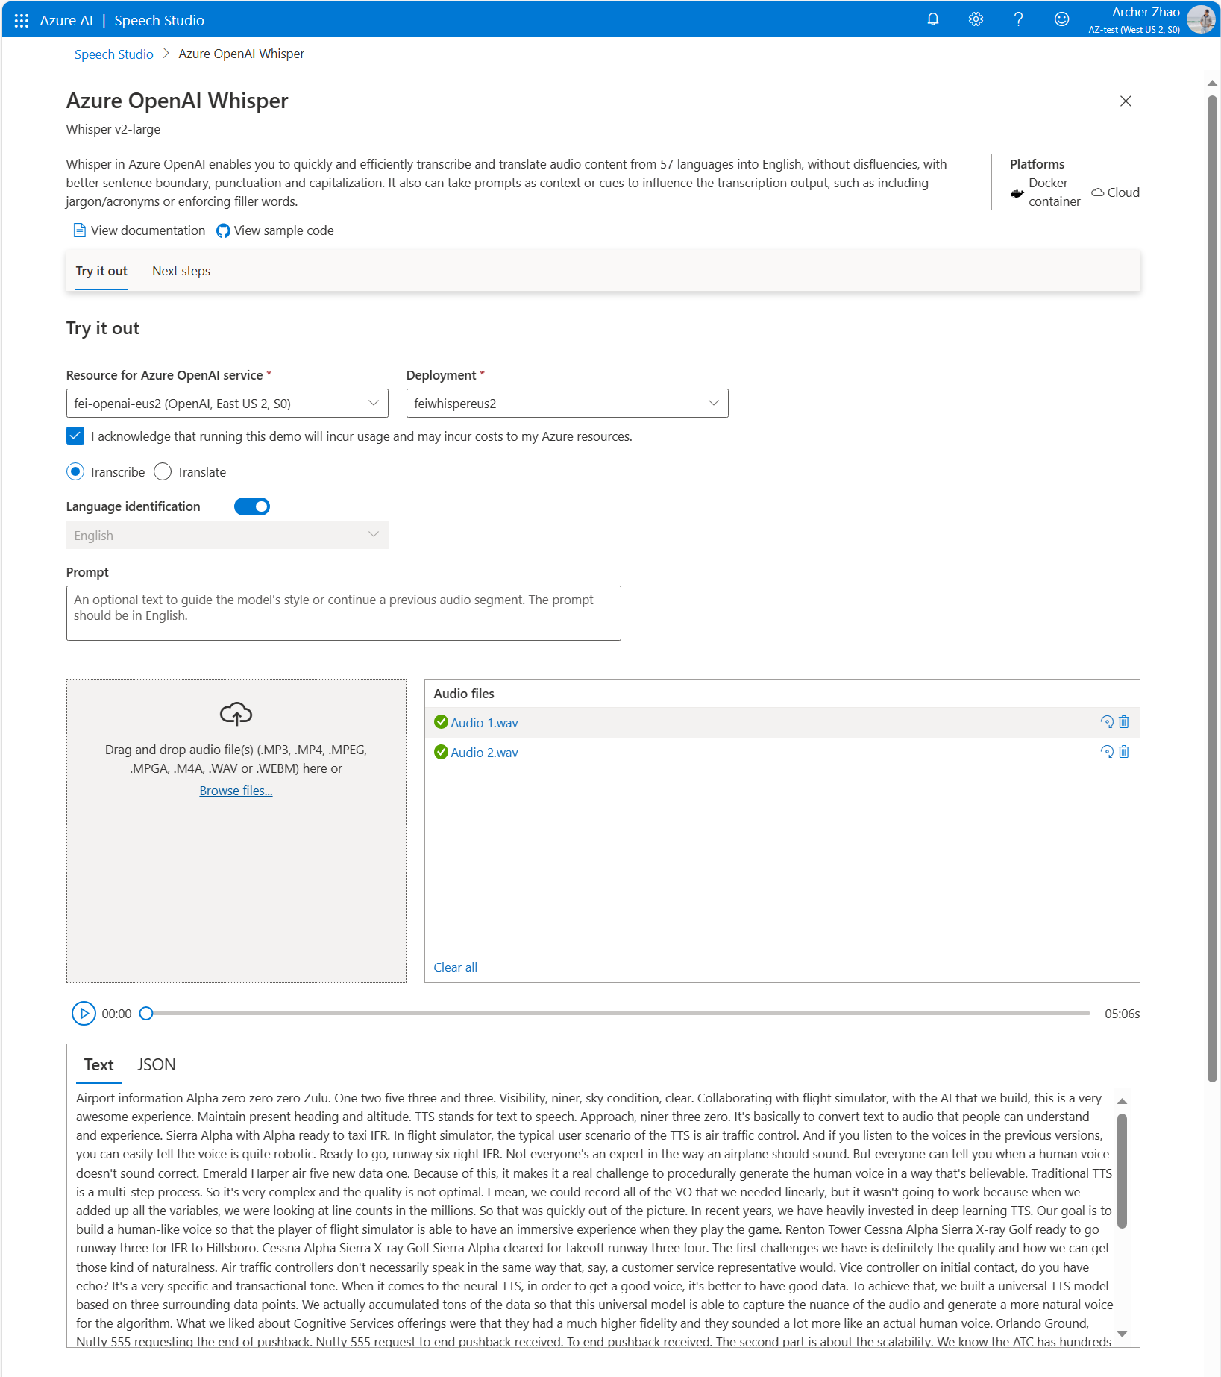
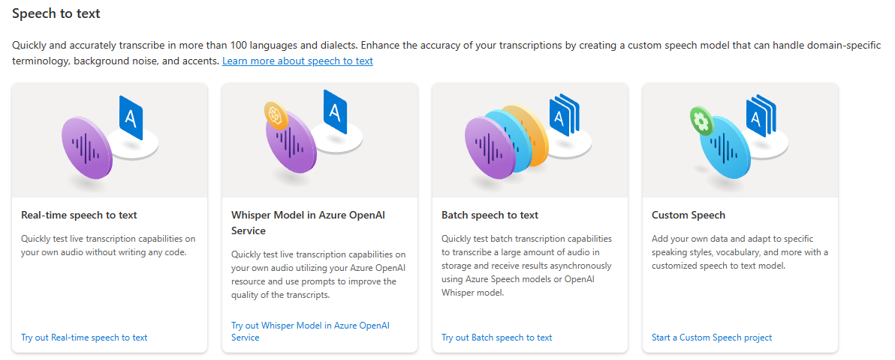
Whisper in Azure OpenAI Service Try-out
Whisper in Azure OpenAI Service
Whisper in Azure OpenAI Service
Try out the Whisper Model with your audio files.
Need to be signed in with Azure OpenAI Service resource.

Slide 106
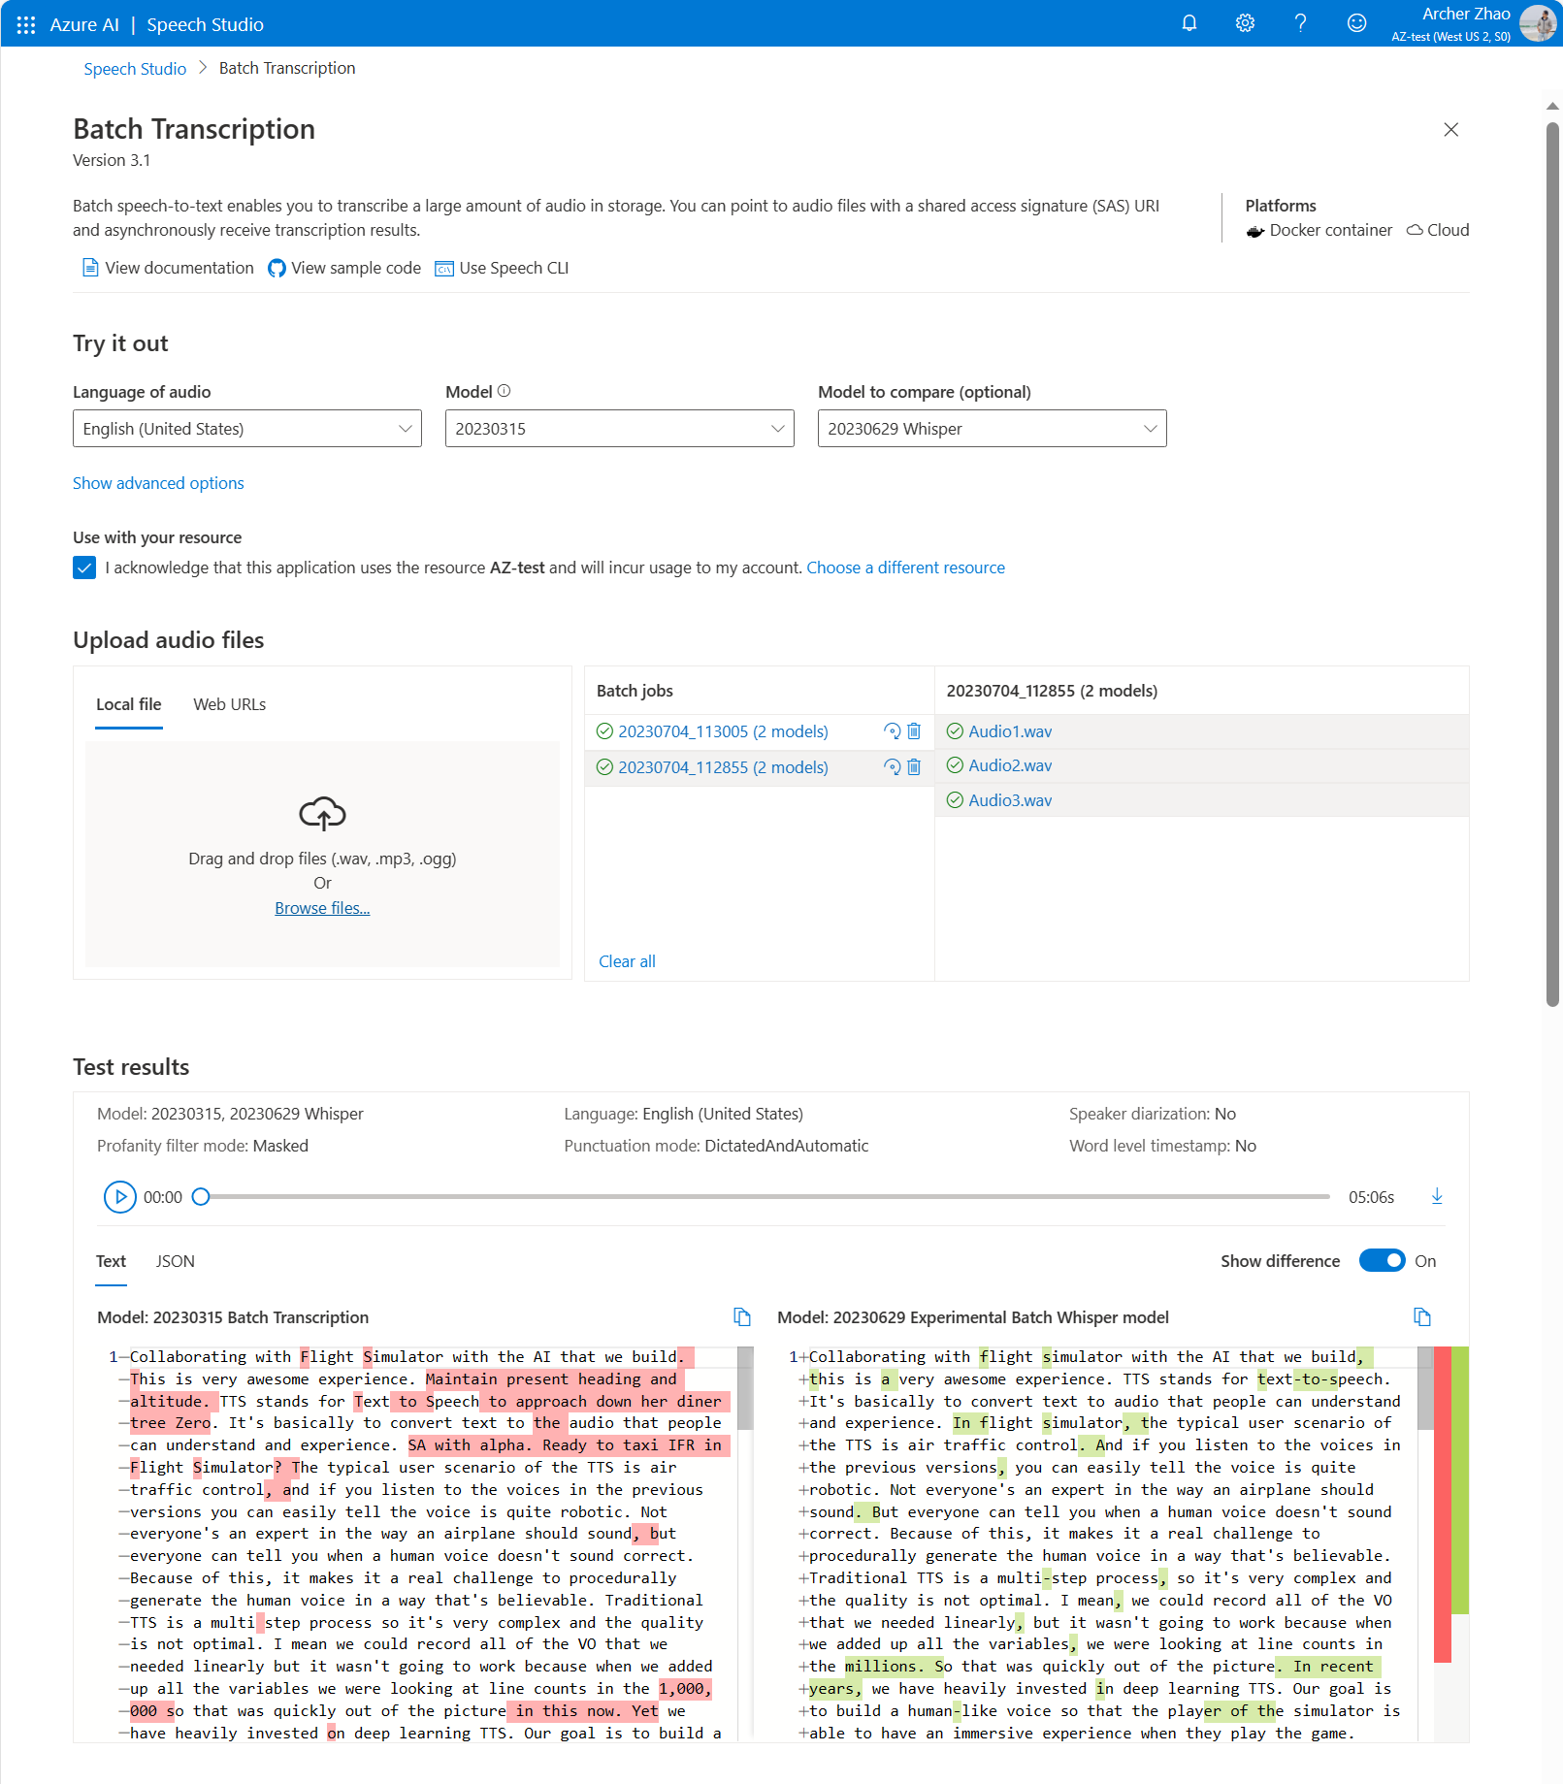
Batch Speech-to-Text Try-out
Evaluate the Whisper Model side-by-side with another Azure AI Speech model
See difference in transcription highlighted
Limited free trial without an Azure resource or signing into Speech Studio (batches of 5 files, up to 1min of audio per file)

Slide 107
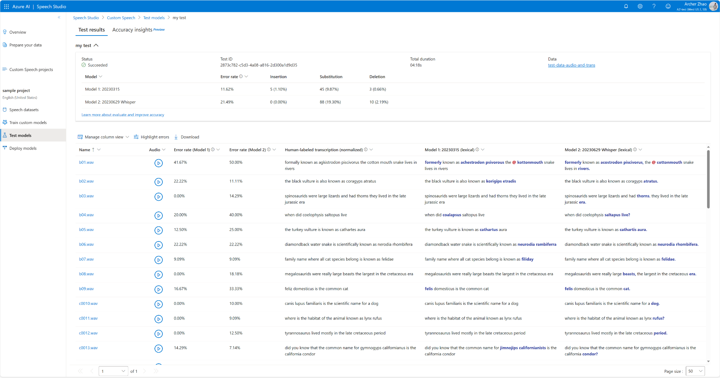
Deeper Evaluation in Custom Speech
Evaluate the Whisper Model and other Azure AI Speech models in depth with transcribed data
See errors highlighted and analyze error rates

Slide 108
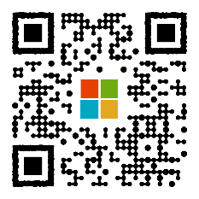
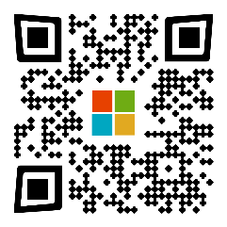

Resources
Bookmark the What’s New Page:
aka.ms/AOAI-Newsfeed
Read thought leadership
aka.ms/AI-Blog
Check out the latest customer stories:
aka.ms/AOAIstories

Slide 109
Thank you

Slide 110
Plugins
Private Preview

Slide 111
langchain - Use plugins from OpenAI on Azure OpenAI - Stack Overflow
Please note that as of now, it is still the private preview stage of first party AOAI plugin, customers will soon be able to use their own plugins with Azure OpenAI Service
Generative AI for Developers: Exploring New Tools and APIs in Azure OpenAI Service (microsoft.com)
How to leverage Plugins for Azure OpenAI Service - Microsoft Community Hub

Slide 112
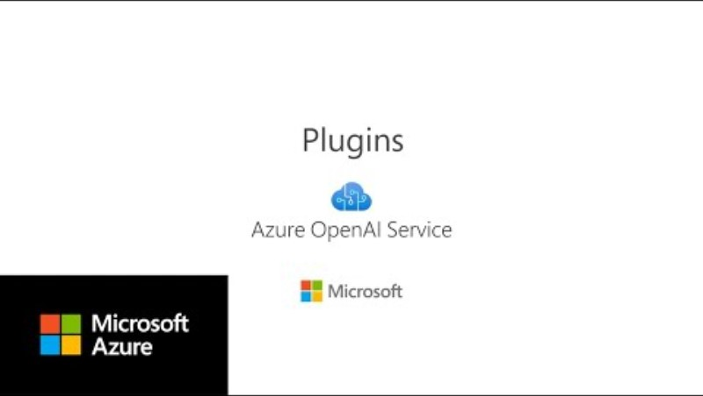

Slide 113

Copilot
Plugins
The digital world

Slide 114
Augment AI systems to access APIs
Retrieve useful information
Plugins
Perform new computations
Safely act on the user’s behalf

Slide 115
Announcing
One plugin extensibility model
Bing Search
Cognitive Search
Azure SQL
Azure CosmosDB
Azure Translator
Custom Plugins
More …

Slide 116
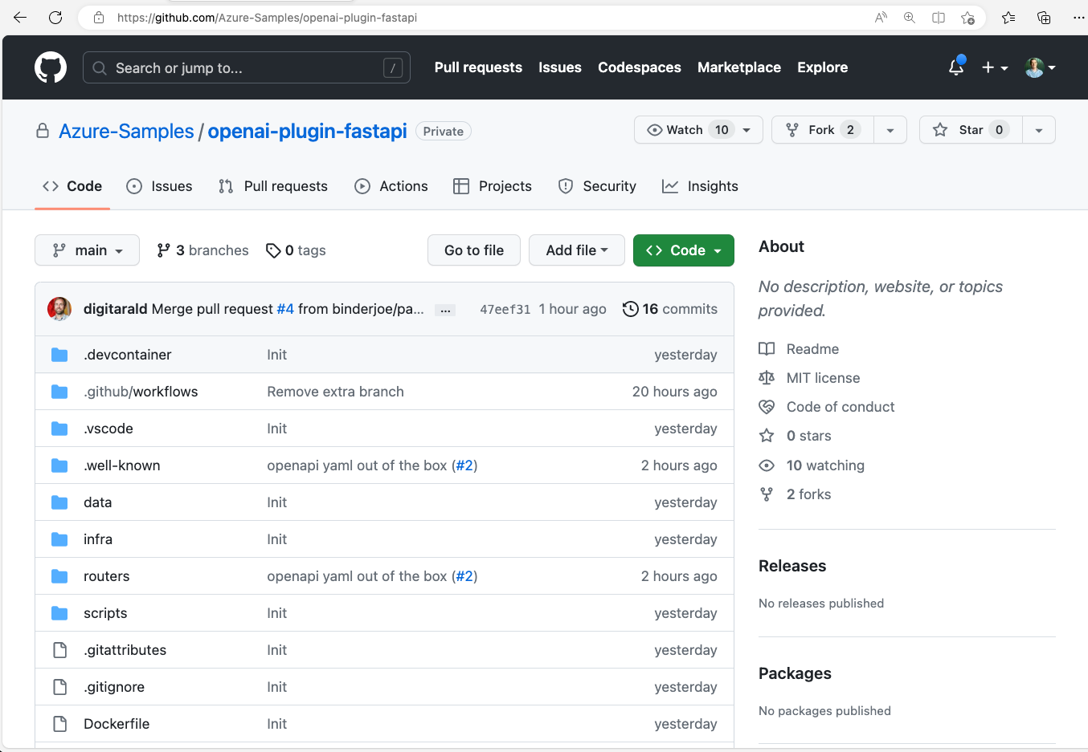
Start building plugins today
https://aka.ms/PluginRepo

Slide 117
Microsoft Fabric
Technical deck

Slide 118
Introducing the new Microsoft Fabric solution

Slide 119

Today’s data value creation challenges
Breaking down data siloes across the organization into a unified source of truth
Balancing the need for data access and self-service analytics while remaining governed
Delivering on the promise of analytics with limited resources
Limited scalability of legacy solutions as data demand rises exponentially

Slide 120

“By 2024, 75% of organizations will have established a centralized data and analytics (D&A) center of excellence to support federated D&A initiatives and prevent enterprise failure.”
Gartner, Our Top Data & Analytics Predicts

Slide 121
The analytics opportunity: accelerate transformative value from your data
91%
76%
32%
of leaders report their organizations have increased investment in data and analytics
of leaders report that democratizing access to AI is important to the success of their organization
of organizations report being able to realize tangible value from data and analytics

Slide 122
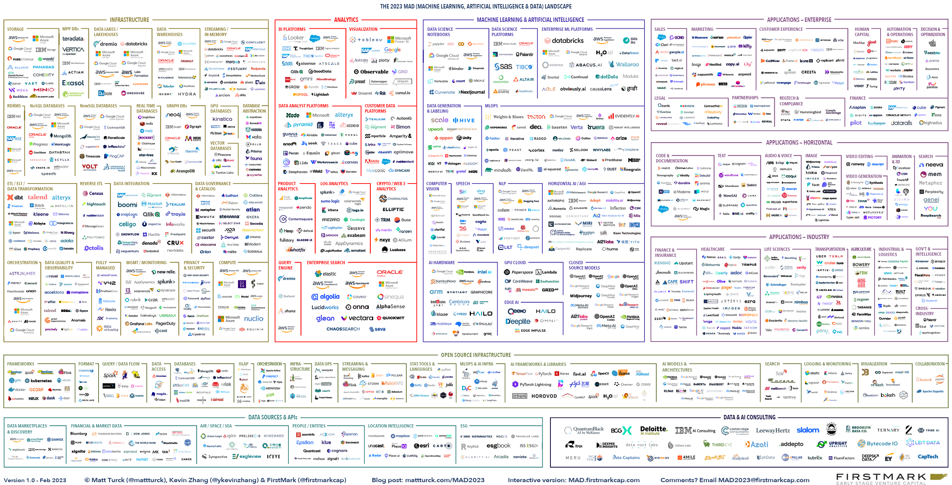
There is massive fragmentation of the modern tech stack
Source: The 2023 ML, AI, and Data Landscape

Slide 123
“
I am the Chief Data Officer and don’t want to be the Chief Integration Officer.
Every CDO, Every Enterprise

Slide 124
Introducing Microsoft Fabric––a unified analytics solution for the era of AI
Single…
Onboarding and trials
Sign-on
Navigation model
UX model
Workspace organization
Collaboration experience
Data Lake
Storage format
Data copy for all engines
Security model
CI/CD
Monitoring hub
Data Hub
Governance & compliance
OneLake
Data Factory
Synapse
Data Engineering
Synapse
Data Warehouse
Synapse
Data Science
Synapse
Real-Time Analytics
Power BI
Data Activator
Lake-centric and open
Role-specific tools
Empower every Microsoft 365 user
Persistent governance and security

Slide 125
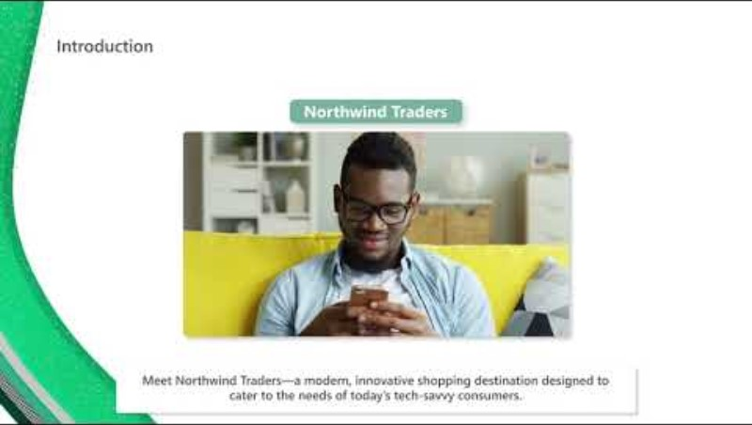

Slide 126




Early customer feedback on Microsoft Fabric
Delivering value across industries
“Fabric will for sure change the way we work by enabling collaboration between cross-functional teams. We’re going to be able to deliver results much faster so the business can make decisions quicker. I think Fabric is going to be huge for our company and for the industry.”
Mike Lopez, Coca-Cola
“I see specific Fabric features really breaking down barriers between disparate data sources. Now, OneLake will allow you to view all those data sources as one single pane of glass. I see Fabric as something that will enable the vision of data mesh, to decrease the lead time between the conception of an idea and the implementation of that data product.”
Simon Nuss, Hitachi Solutions
“The vision to really integrate the Microsoft world into a singular point means that the insight to action is really going to be much better than anyone else and will really stand out. That for me, is really exciting.”
David Bar, KPMG
“What we love, is the SaaS-ification of services, meaning the integration of all services that form an analytical platform in one place.”
Thomas Martens, MunichRE

Slide 127












































Recent wins

Slide 128
Experiences overview

Slide 129
Seven key experiences for end-to-end analytics
Experiences are designed to target specific personas and tasks, yet work together seamlessly in a unified platform via OneLake to enable creators to collaboratively do their best work
Combines the ease of use of Power Query with the scale and Power of Azure Data Factory to leverage 200+ native connectors to data sources on premises and in cloud
World-class Spark platform with great authoring experiences to empower data engineers to transform data at scale
Providing industry leading SQL performance and scale, fully separating compute from storage for independently scaling and natively storing data in open Delta Lake
Build, deploy, and operationalize machine learning models directly within Fabric to empower data scientists and analysts with predictive insights
Best-in-class engine for observational data analytics to create actionable insights from real-time data
The world’s leading business intelligence platform empowers users to quickly and intuitively to make better decisions with data
Automatically drive actions on your data, without writing code

Slide 130








Data integration experience
Bring together low-code, AI-enabled experiences, multi-cloud connectivity, and persistent data security and governance to help solve complex scenarios for all developers
200+ native data source connectors
Data Integration
Data Engineering
Data Warehouse
Data Science
Real Time Analytics
Business Intelligence
Data Activator
Cloud-scale data movement with Data Factory
Data Factory
Synapse
Synapse
Synapse
Synapse
Power BI
Low-code interface for ingesting data from hundreds of data sources using Dataflows Gen2
Serverless Compute
Petabyte scale transformation
OneLake
Powerful, enterprise-grade Data Factory experience with the best of ADF and Power Query together
Security, Governance and Administration

Slide 131

Data engineering experience
Build you data estate and empower data engineers with a world-class Spark platform, fully integrated with Data Factory, to transform and democratize data at scale
World-class Spark serverless compute
Pro and low-code authoring experience
Schedule and orchestrate data transformations with notebooks and Spark jobs
Launch clusters on demand and dynamically scale in, scale out, pause, and resume
Perform code-free interactive data exploration and add to your data pipeline
Data Integration
Data Engineering
Data Warehouse
Data Science
Real Time Analytics
Business Intelligence
Data Activator
Data Factory
Synapse
Synapse
Synapse
Synapse
Power BI
Serverless Compute
OneLake
Security, Governance and Administration

Slide 132
Data warehouse experience
Achieve data platform goals with east and cost efficiency, while empowering your developers and engineers with accelerated reporting and insights
Industry-leading SQL performance and scale, including reporting tools using T-SQL and TDS end-points
Fully separate compute storage that can independently scale
Build relational layers on top of physical data in lakehouse and natively store data in open Parquet/Delta Lake to remove need for data duplicity
Consumer data with Power BI for reporting and visualization
TLS 1.2 encryption protects all connections for granular security across your data platform
Data Integration
Data Engineering
Data Warehouse
Data Science
Real Time Analytics
Business Intelligence
Data Activator
Data Factory
Synapse
Synapse
Synapse
Synapse
Power BI
Serverless Compute
OneLake
Security, Governance and Administration

Slide 133
Data science experience
Build, deploy, and operationalize machine learning models with boundaryless collaboration and seamless integration with Azure ML
Access data from multiple sources and store data and insights in lakehouse(s)
Leverage data science capabilities for model prediction at scale to gain and share business insights
Iterate, build, and track Machine Learning experiments using ML flow
Perform transformation, exploration, and featurization by leveraging built-in experiences
Collaborate with others via Notebook, Power BI, and lakehouses in real-time
Data Integration
Data Engineering
Data Warehouse
Data Science
Real Time Analytics
Business Intelligence
Data Activator
Data Factory
Synapse
Synapse
Synapse
Synapse
Power BI
Serverless Compute
OneLake
Security, Governance and Administration

Slide 134
Real-time analytics experience
Unlock value and turn insights into actions with real-time analysis across telemetry data to better predict, optimize, and improve data applications
High velocity, low latency data analysis capable of indexing diverse data formats and structures up to several petabytes large
Leverage Kusto Query Language (KQL) to explore data and discover patterns, identify anomalies and outliers, and create statistical modeling
Easy ingestion of data from any source, in any data format, like applications, websites, and IoT devices
Democratize data responsibly with Microsoft Purview and use observability with Data Activator to activate timely actions
Data Integration
Data Engineering
Data Warehouse
Data Science
Real Time Analytics
Business Intelligence
Data Activator
Data Factory
Synapse
Synapse
Synapse
Synapse
Power BI
Serverless Compute
OneLake
Security, Governance and Administration

Slide 135

Business intelligence experience
Uncover powerful insights with intelligence visuals, leverage data quickly and intuitively, and help achieve faster and better data-based decisions with the industry leading Power BI platform
Native Integration with Microsoft 365
Powerful built-in AI capabilities and visuals illuminate hidden patterns, opportunities and anomalies in data with the click of a button
Connect to, index, and certify datasets in the Power BI data hub
Build governed databases, like data models or data marts, in a trusted and secure hub
Data Integration
Data Engineering
Data Warehouse
Data Science
Real Time Analytics
Business Intelligence
Data Activator
Data Factory
Synapse
Synapse
Synapse
Synapse
Power BI
Serverless Compute
OneLake
Security, Governance and Administration

Slide 136

Data Activator experience
Eliminate manual monitoring of operational dashboards. Automatically detect actionable conditions in your data, then drive alerts and actions, without writing code.
Automatically monitor Power BI datasets and event streams.
Define no-code rules to detect actionable conditions in your data.
Send alerts in Microsoft Teams or email when actionable conditions occur.
Combine Data Activator with Power Automate to send alerts via 3rd party systems, or trigger actions in ticketing systems and other apps.
Data Integration
Data Engineering
Data Warehouse
Data Science
Real Time Analytics
Business Intelligence
Data Activator
Data Factory
Synapse
Synapse
Synapse
Synapse
Power BI
Serverless Compute
OneLake
Security, Governance and Administration

Slide 137

Serverless compute
Run workloads without having to provision compute. Live compute pools are already provisioned with a workspace resulting in instant productivity.
Limitless scale for the most demanding jobs
Automatically create with each workspace With support for high concurrency mode there’s no need to start a new session to run a notebook Memory optimized
Data Integration
Data Engineering
Data Warehouse
Data Science
Real Time Analytics
Business Intelligence
Data Factory
Synapse
Synapse
Synapse
Synapse
Power BI
Serverless Compute
OneLake
Security, Governance and Administration

Slide 138
Unified data foundation with OneLake
Eliminate pervasive and chaotic data siloes to provide a unified, secure, and centralized storage system for developers with OneLake––the “OneDrive” for data
A single SaaS lake for the whole organization
Abstraction layer over Azure Storage and third-party storage services, provisioned automatically with the tenant
All workloads automatically store their data in OneLake workspace folders
All data is organized in an intuitive hierarchical namespace
Data in OneLake is automatically indexed for discovery, sharing, governance, and compliance
Data Integration
Data Engineering
Data Warehouse
Data Science
Real Time Analytics
Business Intelligence
Data Factory
Synapse
Synapse
Synapse
Synapse
Power BI
Serverless Compute
OneLake
Security, Governance and Administration

Slide 139

Persistent data governance and security
Built-in security and reliability features secure your data, and a set of governance and compliance capabilities help you manage, protect, and monitor sensitive information
Centralized Administration via the Admin Center
Governance powered natively by Microsoft Purview Insights via Admin Monitoring, Capacity Insights and more, enabling effective administration and governance Security at Data, Workspace and Network layers Key enterprise promises like data residency, auditability and much more
Data Integration
Data Engineering
Data Warehouse
Data Science
Real Time Analytics
Business Intelligence
Business Intelligence
Data Factory
Synapse
Synapse
Synapse
Synapse
Power BI
Power BI
Serverless Compute
OneLake
Security, Governance and Administration

Slide 140
OneLake overview

Slide 141
OneLake for all domains
A true data mesh across organization domains
Sales
Marketing
Finance
Introducing domains as an integral part of Fabric: A domain is a way to logically group together all the data in an organization relevant to an area or field, according to business needs
Data
warehousing
Data
engineering
Data integration
Data
science
Real-time
analytics
Business intelligence
Domains are defined with domain admins and contributors who can associate workspaces and group them together under a relevant domain
Federated governance can be achieved by delegating settings to domain admins, thus allowing them to achieve more granular control over their business area
Unified management and governance
OneLake
Domains simplify discovery and consumption of data across the organization, thus allowing business optimized consumption
Sales
Marketing
Finance
Workspace
POS sales
Certified
Workspace
online sales
Certified
Workspace
customer
Workspace
ads
Promoted
Workspace
expenses
Avoid data swamps by endorsing certain data as certified or promoted, thus encouraging reuse.

Slide 142
OneLake for all data
“The OneDrive for data data”
A single SaaS lake for the whole organization
Provisioned automatically with the tenant
All workloads automatically store their data in the OneLake workspace folders
All the data is organized in an intuitive hierarchical namespace
The data in OneLake is automatically indexed for discovery, MIP labels, lineage, PII scans, sharing, governance and compliance
Data Integration
Data Engineering
Data Warehouse
Data Science
Real Time Analytics
Business Intelligence
Serverless
Compute
Spark
T-SQL
KQL
Analysis Services
OneLake
Storage
Warehouse
Lakehouse
KQL DB
Semantic Dataset
Delta – Parquet Format
Delta – Parquet Format
Delta – Parquet Format
Delta – Parquet Format

Slide 143
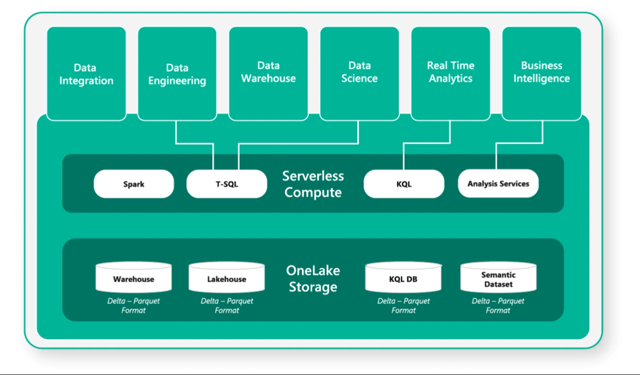
One copy for all computers
Real separation of compute and storage
All the compute engines store their data automatically in OneLake
The data is stored in a single common format
Delta – Parquet, an open standards format, is the storage format for all tabular data
Once data is stored in the lake, it is directly accessible by all the engines without needing any import/export
All the compute engines have been fully optimized to work with Delta Parquet as their native format
Shared universal security model is enforced across all engines

Slide 144
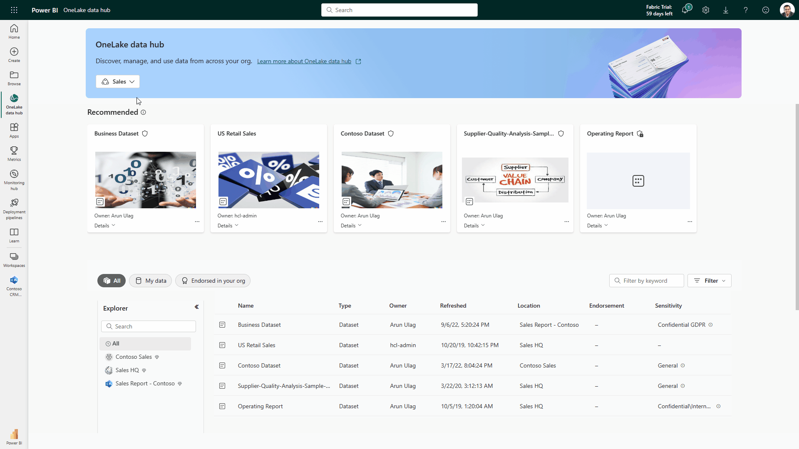
OneLake data hub
Discover, manage, and reuse data in one place
Central location within Fabric to discover, manage, and reuse data. Pervasive experience – available everywhere users discover data (create shortcuts, get data in dataflow, attach a notebook, create a dataset, and more).
Data can be easily discovered by its domain (e.g., Finance) so users can see what matters to them.
Efficient data discovery using search, filter and sort, or via browsing by folder (workspace) hierarchy.
Data actions such as preview, exploration, tracking lineage, report creation, analyze in Excel, and export can be easily done, even by non-technical users.
Available in Microsoft Teams, thus bringing OneLake Data hub to Office, enabling both technical and non-technical users with discovery, reuse and exploration.

Slide 145
Experiences deep dive

Slide 146


Microsoft Fabric does it all––in a unified solution
Unified SaaS-based solution that stores all organizational data where analytics workloads operate
Data Integration
Data Engineering
Data Warehouse
Data Science
Real-Time Analytics
Business Intelligence
Data Activator
Data Factory
Synapse
Synapse
Synapse
Synapse
Power BI
Serverless Compute
OneLake
Security, governance, and administration

Slide 147

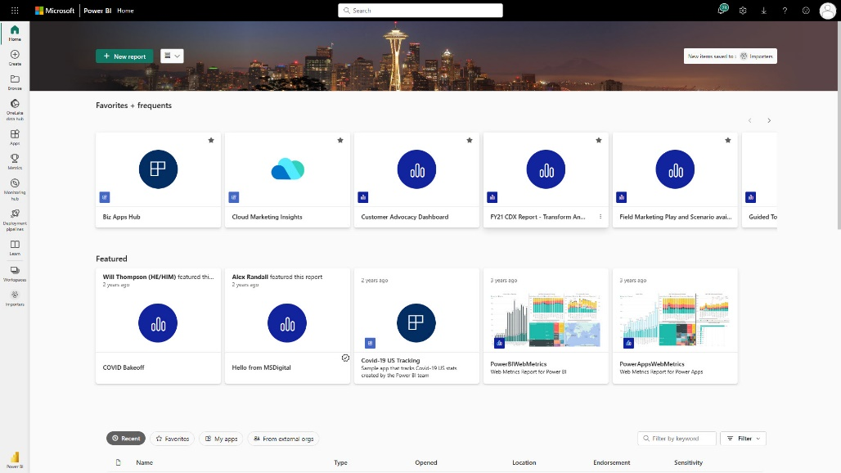
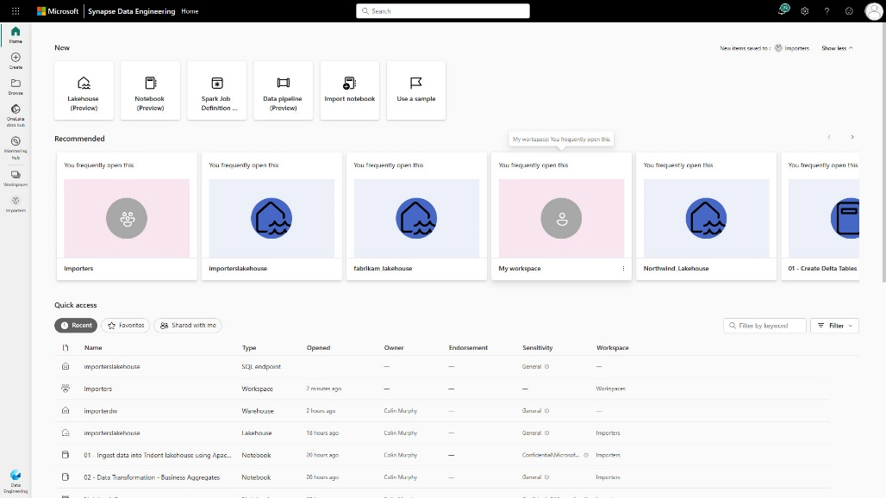
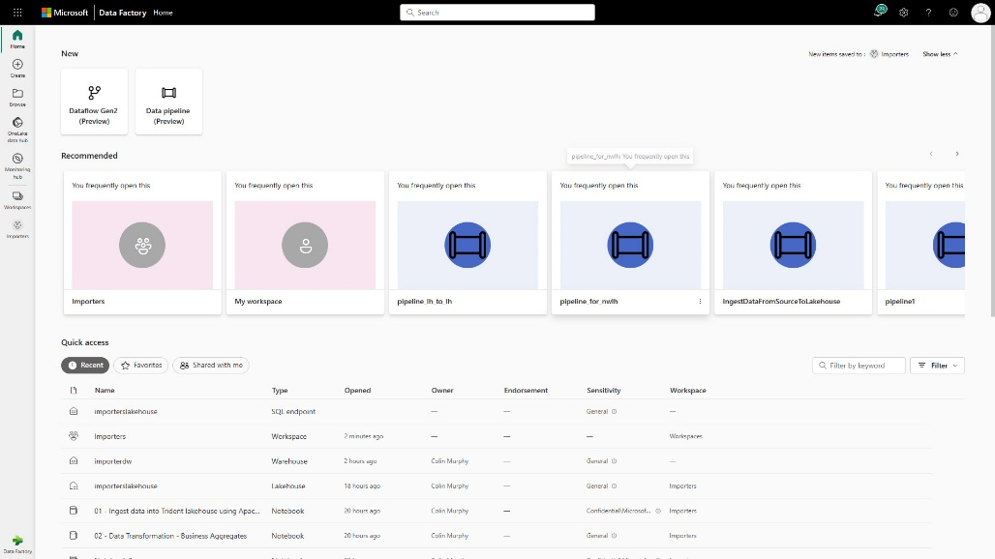
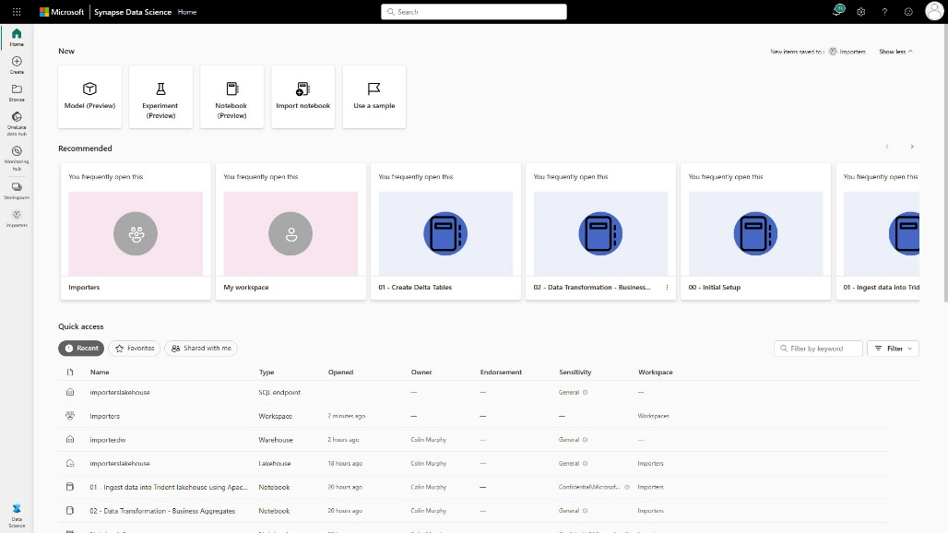
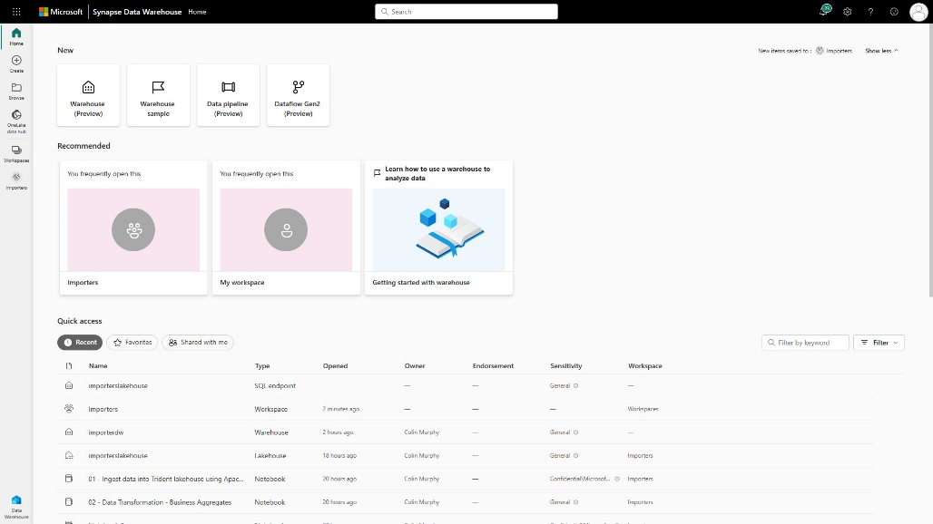
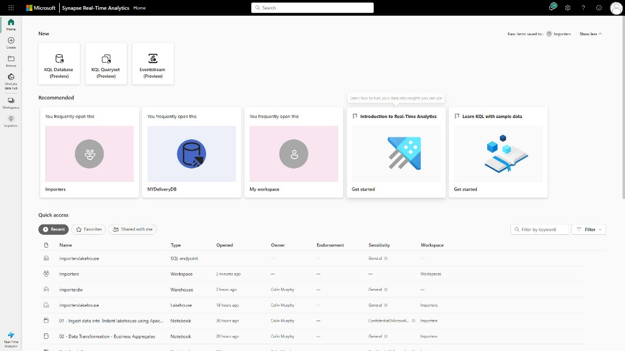
Persona optimized experiences

Slide 148

Learn more about these experiences
Navigate to specific experiences and capabilities using the links below
Get started
Power BI
OneLake
Data Factory
What is Fabric?
Microsoft Fabric licenses
Buy a Microsoft Fabric subscription
Navigate the Fabric portal
Workspaces in Fabric
See more
Enable Microsoft Fabric for your
organization
What is Power BI?
What is a datamart?
Azure and Power BI integration
See more
What is OneLake?
What are shortcuts?
Create a lakehouse with OneLake
OneLake and Azure Synapse Analytics
integration
See more
What is Data Factory?
Create your first pipeline
Create your first dataflow
Connectors
See more
Synapse Data Engineering
Synapse Data Science
Synapse Data Warehouse
Synapse Real-Time Analytics
Data Activator
What is Data Engineering?
Create a Lakehouse
Create a Spark job definition
See more
What is Data science?
Machine learning experiment
Use end-to-end AI samples
See more
What is Data Warehouse?
Create a Warehouse
Query using SQL query editor
See more
What is Data Activator?
Getting started
Get data
See more
What is Real-Time Analytics?
What is Event stream?
Create a database
See more
Security, Governance, and Administration
Buy a Microsoft Fabric subscription | Fabric administration | Data governance and compliance | Security | See more

Slide 149
Data integration

Slide 150




Data integration scenario
End-to-end analytics scenario
Data Source
Ingestion
Transform
Store
Expose
Structured / Unstructured
Pipeline
Dataflows Gen2
Lakehouse
Business Intelligence
Orchestration & Notification
Pipeline

Slide 151

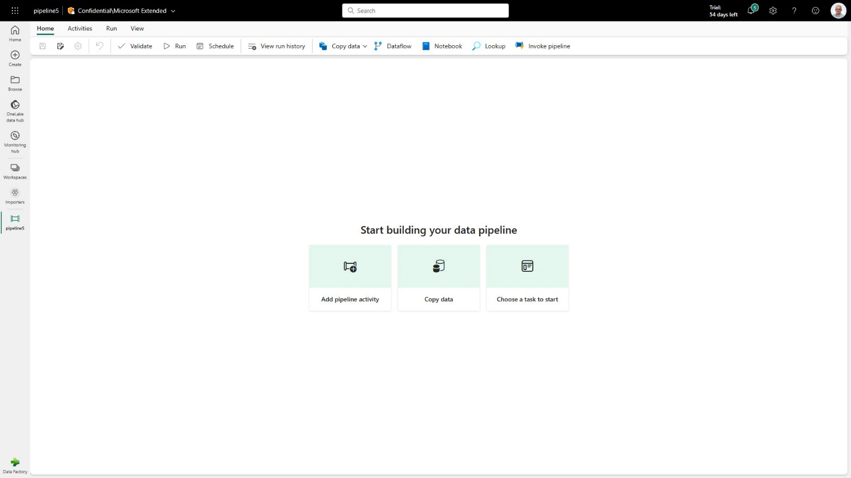
Data Factory
Data Factory in Microsoft Fabric provides cloud-scale data movement and data transformation services that allows you to solve the most complex ETL scenarios
Core to Data Factory are Data Pipelines and Dataflows to give users the option to a low-code, collaborative and enterprise scale approach for their ETL process.
Latest capabilities:
Output destination to Lakehouse
14 New connectors available in Pipeline copy activity
Warehouse connector for PBI Desktop
Sample datasets
Pipeline Lakehouse copy assist
Create data pipeline in Lakehouse portal
Pipeline templates
Pipeline support for Spark notebooks
Service principle auth support
Autonomous ETL can unlock operational efficiencies and help orchestrate, monitor and manage pipeline performance.

Slide 152
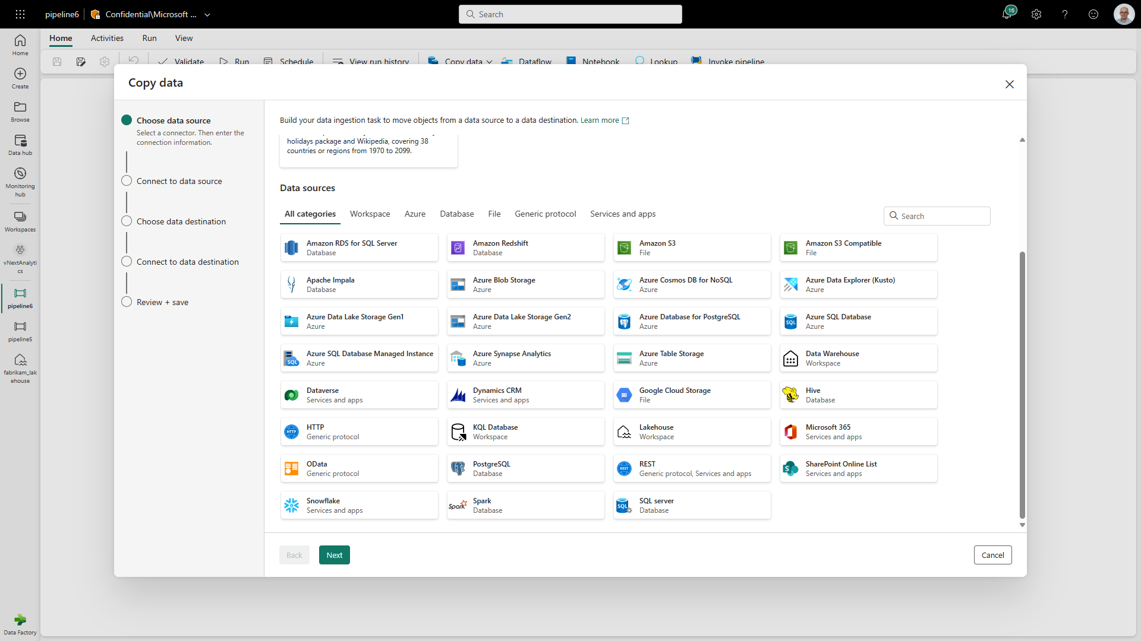
Data Pipelines
Data Pipelines enable powerful workflow capabilities at cloud-scale like building complex workflows, moving PB-size data, and defining sophisticated control flow pipelines
Data pipelines can be used to build complex ETL and data factory workflows that can perform a number of different tasks at scale. Additionally, control flow capabilities are built into pipelines so you can build workflow logic which provide loops and conditional

Slide 153
Data Pipelines |
Connectors
New Connectors provide a low-code interface for ingesting data from a variety of data sources​
New Connectors:
Warehouse Connector; connect to existing Azure Synapse
Lakehouse connector
14 new connectors in the copy activity: Amazon S3, Azure Table, Amazon Redshift, OData, Google Cloud Storage, Apache Impala, Hive, SQL Server, Azure Synapse Analytics, HTTP, REST, PostgreSQL, Azure Database for PostgreSQL, and Azure Data Explorer

Slide 154
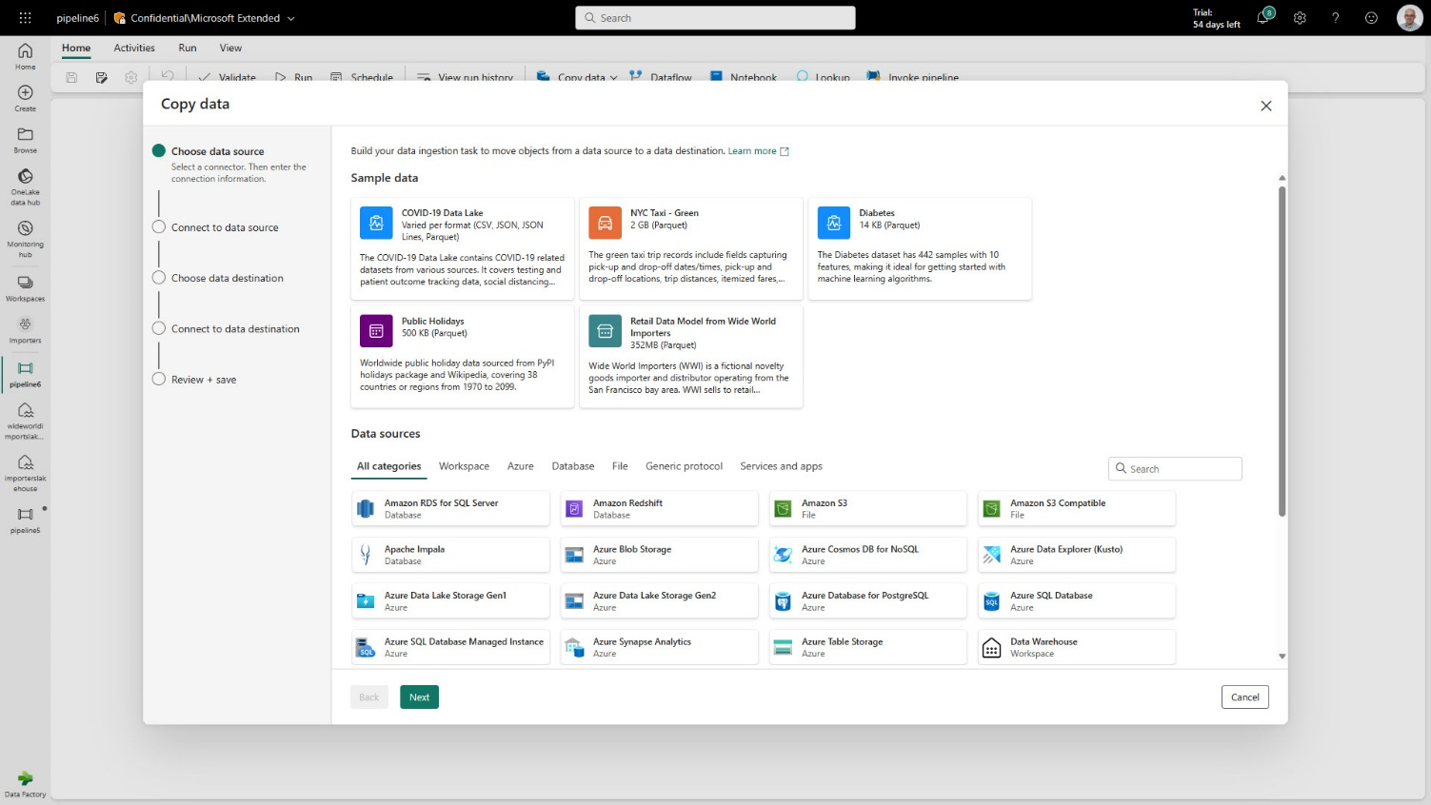
Data Pipelines |
Sample data
Sample Datasets helps new users get started quickly, building out their ELT processes using Data Pipelines
Sample Datasets:
COVID-19 Data Lake (CSV, JSON, JSON Lines, Parquet)
NYC Tax – Green (2GB Parquet)
Diabetes (14K Parquet)
Public Holidays (500KB Parquet)
Retail Data Model from Wide World Importers (352MB Parquet)

Slide 155


Data Pipelines |
Lakehouse copy assist
Simply copying data to a Lakehouse with copy assist capabilities withing the Data Pipeline
Additionally, user can create a Data Pipeline without having to leave the Lakehouse portal

Slide 156

Data Pipelines |
Templates
Quickly get started with data integration
Template help reduce development time by providing an easy way to create pipeline for common data integration scenarios.
Available Data Pipeline Templates:
Bulk copy from Database
Bulk copy from File to Database
Copy data from ADLS Gen2 to Lakehouse file
Copy from ADLS Gen2 to Lakehouse Table
Copy data from Azure AQL DB to Lakehouse Table
Copy multiple files containers between File Stores
Copy new files only by Last Modified Date
Delete files older than 30 days
Delta copy from Database
Move files

Slide 157

Dataflow
Dataflow provide a low-code interface for ingesting data from hundreds of data sources
Dataflow quickly and easily unify disparate data sources, establish a more collaborative analytics approach, and promote more informed, agile decision making.
Key Capabilities:
Accelerate data transformation with code-free data flows
Standardize dataflows in Power Apps support for loading data
Load results of data transformations into multiple destinations (Azure SQL Databases, Lakehouse, etc.)

Slide 158

Dataflow |
Output to Lakehouse
Simply write into a Lakehouse from a Dataflow
Users select the Lakehouse output destination from the list and configure the connection.
This requires the Lakehouse connector to be installed as a custom connector into your data gateway when loading data from on-premise

Slide 159
Data engineering

Slide 160
Lakehouse scenario
End-to-end analytics scenario
Data Source
Ingestion
Store
Expose
Shortcut Enabled
Shortcuts
Lakehouse(s)
Business Intelligence
Structured / Unstructured
Pipelines & Dataflows
SQL endpoint
Transform
Notebooks & Dataflows

Slide 161



Lakehouse | Overview
Store, manage and analyze all your data in a single location & easily share across the entire enterprise
Quickly and easily create a Lakehouse without having to provision and configure compute, storage and networking
Key Capabilities:
Flexible and scalable solution that enables organizations to handle large data volumes of all types and sizes
Built-in SQL endpoint unlocks data warehouse capabilities on top of your Lakehouse with no data movement
Use ‘direct lake’ mode to build reports in seconds directly on top of the data lake with blazing fast performance
Easily ingest data into the Lakehouse through a variety of methods
Share your Lakehouse as a data product with consumers

Slide 162

Spark Runtime
Get started with running Spark in a matter of seconds
Instance performance with starter pools of Spark compute readily available
Key Capabilities:
High concurrency mode enables users to share Spark sessions across multiple notebooks
Attaching a notebook to an existing session results in lightning-fast session start up speed <5 seconds.
Delta Lake enables ‘OneCopy’ allowing all Microsoft Fabric compute engines to seamlessly share data
All Microsoft Fabric items automatically write Delta with V-Order optimization providing lightning-fast analytics for reporting with Power BI

Slide 163

Spark Runtime |
Performance
Continuous optimized & built-in autotuning
Delivering increased performance by default
Key Capabilities:
Increased performance with Fabric runtime 1.1, which brings major updates such as upgrading Spark to 3.3.1, Delta to 2.2 and Python to 3.10
Partition Cache - enhance your query performance by storing filtered partition information in a session-level cache (~10% performance boost).
Cross join multiple scalar subqueries – merge them in a single plan to reduce computation time (~5% performance improvement)

Slide 164

Spark Runtime |
Monitoring
Monitor the progress & built-in a of Spark applications, brows historical jobs, and view related activities
The Monitoring Hub serves as a centralized portal for all jobs including your Spark applications
Key Capabilities:
Dive into a more detailed analysis exploring Spark jobs, task information
View all related items along with their respective snapshots and associated code input & output parameters
Spark UI and History Server integration offers native open-source capabilities to augment Spark monitoring and debugging

Slide 165

Notebook |
Overview
Immersive authoring experience for data developers
Rich notebook capabilities including native Lakehouse integration, real-time collaboration with commenting support, auto-save support, lightweight scheduling and pipeline integration
Key Capabilities:
Manage your Python and R libraries through in-line installs using commands like %pip install
Advanced notebook development support with ability to reference notebooks in notebooks, and snapshots for easy troubleshooting
In context monitoring complete with real time advice and error analysis
Streamline data prep without giving up the power of reproducibility of Python

Slide 166

VS CODE |
Integration
Empower pro developers to use their tools of choice for their development
Launch the Fabric VS Code extension, navigate through your workspace and work with Notebooks, Spark Jobs and Lakehouses directly in the IDE
Key Capabilities:
Run and debug notebook cells or standard batch jobs on the remote Spark cluster
Have the flexibility to work offline with a local environment and push your changes online when needed

Slide 167
OneLake
OneLake is a single unified logical data lake for the whole organization, the foundation for Microsoft Fabric
It is an abstraction layer over first and third-party storage services, pre-provisioned for each tenant, to simplify experiences without the need to understand infrastructure concepts. It eliminates siloes caused by isolated storage accounts with a single, unified storage system and single-pane-of-glass file system
Automatically provisioned with every Microsoft Fabric tenant with no infrastructure to manage.
OneLake
Workspace A (Folder)
Workspace B (Folder)
Lakehouse 1 (Folder)
Warehouse 1 (Folder)
Folders / Files
Folders / Files
Artifacts are prewired to store data in OneLake in open formats
Lakehouse 2 (Folder)
Lakehouse 3 (Folder)
Key Capabilities:
Virtualize data across domains and clou into a single logical data lake using shortcuts
Support open access with DLS Gen2 APIs and SDKs, with no lock-in to proprietary technologies or formats
Hierarchical nature to ensure ease of management across the organization – easily secure data by granting or limiting access
Store data artifacts natively in open-source formats to access across multiple analytical engines without data duplication
Create multiple workspaces, each with the ability to contain multiple lakehouses
Folders / Files
Folders / Files
Unified Management and Governance
Out of the box governance such as data linage,
data protection, certification catalog
integration etc., are all included with OneLake.

Slide 168
OneCopy
OneCopy provides real separation of compute and storage
Save time by only loading your data into the lake once
Synapse Data
Science
Synapse Data Warehousing
Data
Factory
Synapse Data
Engineering
Synapse Real Time Analytics
Power BI
Data Activator
Key Capabilities:
All the compute engines store their data automatically in OneLake
The data is stored in a single common format
Delta-Parquet is the storage format for all tabular data in Analytics vNext
Once data is stored in the lake, it is directly accessible by all the engines without needing any import/export
All the compute engines have been fully optimized to work with Delta Parquet as their native format
Shared universal security model enforced across all engines
Serverless
Compute
Spark
T-SQL
KQL
Analysis Services
OneLake
Customers 360
Finance
Service Telemetry
Business KPIs
Delta – Parquet Format
Delta – Parquet Format
Delta – Parquet Format
Delta – Parquet Format

Slide 169



Shortcuts
Shortcuts unify data without copying
or moving existing data
This means that data can be used multiple times
without data duplication.
Synapse Data
Science
Synapse Data Warehousing
Data
Factory
Synapse Data
Engineering
Synapse Real Time Analytics
Power BI
Data Activator
OneLake
Key Capabilities:
Create shortcuts within Microsoft Fabric to consolidate data across artifacts or workspaces, without changing ownership of the data
With shortcuts, data throughout OneLake can be composed together without any data movement
Shortcuts also allow instant linking of data already existing in Azure and in other clouds, without any data duplication and movement, making OneLake the first multi-cloud data lake
With support for industry standard APIs, OneLake data can be directly accessed by any application or service
Customers 360
Finance
Service Telemetry
Business KPIs
Azure
Amazon
Google

Slide 170
Data science

Slide 171
Data science scenario
End-to-end analytics scenario
Data Source
Clean & prepare
Store
Expose
Lakehouse & Data Warehouse
Notebooks
Lakehouse(s)
Business Intelligence
Train test & apply
SQL endpoint
Experiments
Models

Slide 172

Explore, clean
and prepare
Faster exportation, cleansing and transformation of data with built-in experiences as part of the data science workload
Data Science workloads supports data cleansing, transformation, exploration, and featurization by leveraging built-in experiences on Spark as well as Python based tools
Key Capabilities:
Accelerate tedious and mundane tasks with Data Wrangler, a code tool to prepare data and generate Python code
Simplify data analytics, capture and exploit data semantics as users perform transformations on datasets
Leverage pre-installed open-source libraries for building visualizations like matplotlib, seaborn, Plotly, and more

Slide 173

Machine Learning
with MLFlow
Built-in model & experiment tracking enables data scientists to track and compare their different experiment runs and model versions
Train, evaluate, and score machine learning models by using built-in Experiment and Model artifacts
Key Capabilities:
Seamless integration with MLFlow for experiment tracking and model registration/deployment
Automatically capture model pemtrics & parameters with built-in support for MLFlow auto-plogging
SynapseML integration with Azure OpenAI service makes it easier to use Apache Spark to process millions of prompts and scale workflow
Model registry powered by AzureML

Slide 174

Model scoring
Easily enrich your data stored in the lakehouse with machine learning predictions
Leverage Predict to score data at scale and write it back to your Fabric lakehouse
Key Capabilities:
Predict can be invoked from the secure boundaries of a Fabric notebook using APIs for maximum flexibility
Leverage Predict directly from the UI using a guided experiment to deploy models in a matter of clicks
Seamless integration with the lakehouse, OneLake and Direct Lake meaning it is super simple to get your predictions into Power BI reports

Slide 175
Data warehouse

Slide 176
Data warehouse scenario
End-to-end analytics scenario
Data Source
Ingestion
Store
Expose
Structured
Pipelines & Dataflows
Data Warehouse
Business Intelligence
Warehouse
Transform
Procedures

Slide 177


Data warehouse | Overview
Enterprise scale data warehouse with open standard format
No knobs performance with minimal set-up and deployment, no configuration of compute or storage needed
Key Capabilities:
Simple and intuitive warehouse experiences for both beginner and experienced data professionals
Lake-centric warehouse stores data in OneLake in open Delta format with easy data recovery and management
Fully integrated with all Fabric workloads out-of-the box
Data loading and transforms at scale, with full multi-table transactional guarantees provided by the SQL engine
Virtual warehouses with cross-database querying and a fully integrated semantic layer
Enterprise-ready platform with end-to-end performance and usage visibility, with built-in governance and security
Flexibility to build data warehouse or data mesh based on organizational needs and choice of no-code, low-code, or T-SQL for transformations

Slide 178
Data loading and transforms at scale
High scale data loading from any source.
Data managed by Warehouse compute engine provides full multi-table transaction guarantees
COPY INTO table_name.[(Column_list)] FROM ‘<external_location>’ [,...n] WITH ( [FILE_TYPE = {'CSV' | 'PARQUET' '} ] [,CREDENTIAL = (AZURE CREDENTIAL) ]
[,ERRORFILE = '[http(s)://storageaccount/container]/errorfile_directory[/]]'
[,ERRORFILE_CREDENTIAL = (AZURE CREDENTIAL) ]
[,MAXERRORS = max_errors ] [,COMPRESSION = { 'Gzip' | ’Snappy’}] [,FIELDQUOTE = ‘string_delimiter’] [,FIELDTERMINATOR = ‘field_terminator’] [,ROWTERMINATOR = ‘row_terminator’] [,FIRSTROW = first_row] [,ENCODING = {'UTF8'|'UTF16’}]
);
Key Capabilities:
Integration with Data Factory Pipelines
Data published to OneLake as Delta tables
Support for multi-statement transactions
Supports snapshot isolation
T-SQL support for:
COPY command
CTAS
INSERT … SELECT
Common Table Expressions
Locking:
INSERT and SELECT require schema stability lock
UPDATE and DELETE do not lock tables
CREATE TABLE [warehouseA].[dbo].[FactInternetSales_new]
AS
SELECT * FROM [warehouseB].[dbo].[FactInternetSales];
INSERT INTO dbo.EmployeeSales
SELECT sp.BusinessEntityID, c.LastName, sp.SalesYTD
FROM warehouseA.Sales.SalesPerson AS sp
INNER JOIN warehouseB.Person.Person AS c
ON sp.BusinessEntityID = c.BusinessEntityID
WHERE sp.BusinessEntityID LIKE '2%'
ORDER BY sp.BusinessEntityID, c.LastName;

Slide 179

Virtual warehouses and cross database querying
Eliminate the need to duplicate data from any Lakehouse to any Warehouse
Customers can query data in the lake without the need for data movement, reducing costs
Key Capabilities:
Build virtual warehouses by creating Lakehouses with shortcuts to data in the Lake
Query across Warehouse and Lakehouse SQL Endpoint with zero data movement
Write T-SQL query with 3-part-naming for cross-joining
Build queries visually using the Visual Query Editor

Slide 180

Fully integrated Power BI semantic layer
Reduce integration and gain insight from your data in seconds
Built-in Power BI enables everyone to visualize their data in seconds.
Key Capabilities:
Auto-generated Power BI dataset always in sync
Default dataset in Direct Lake mode but automatically switches to Direct Query or Import mode as security or performance needs change
Flexibility to add/remove tables to dataset
Full web authoring experience for creating measures

Slide 181
No Knobs Performance at scale with open data format
Single node performance
Performance at Scale
(
Query optimizer
Efficiency
Query processor
Throughput
)
Multi node distribution
SQL Server QO
The best query optimizer in the industry
VertiPaq
The fastest columnar query processor in the world (originated from Power BI)
Polaris
The most scalable distributed query processor in the world with the only published Petabyte scale benchmark (VLDB 13, August 2020)

Slide 182

Autonomous workload management
Eliminate need to manually manage different types of workloads
Built-in autonomous workload management, provides workload performance isolation and scales based on demand without any setup
…..
Query
Key Capabilities:
Workloads automatically detected and isolated based on SQL statement types
Isolated compute used for loading data, providing predictable performance for ETL
Distributed query processor auto-scales as demand increases
…..
Ingestion

Slide 183

Automatic multi-tiered caching
SQL Frontend
Result Set Caching
Get best performance out of the box
Automatic caching at multiple tiers provides top performance for queries out-of-the-box and reduces management and tuning overhead
Backend Compute Pool
Key Capabilities:
In memory caching done automatically and caching is sticky based on activity
SSD caching reduces latency in fetching from OneLake (coming soon)
Result set caching provides instant performance for repetitive queries (coming soon)
…
…
OneLake
……

Slide 184

Unified query optimization
Pull relevant metadata
Simplify query
Get best performance out-of-the-box at lowest cost
Query plan provides top performance for queries out-of-the-box at cheapest cost
Create missing statistics
Cost-based optimization
(alternatives, cost estimation)
Key Capabilities:
Query plan with optimal # of nodes for each step with efficient resource consumption automatically created
Ability to create user-defined statistics manually
Automatic statistics generated at query time (coming soon)
Plan of high quality in reasonable time
(size of search space, accuracy of estimation)
Step 1
Step 2
Step 3
Step 4
Step 5

Slide 185
Monitoring through dynamic management views
Get insights into SQL query lifecycle
Customers can view query performance and easily terminate any noisy or costly queries
-- Identifies long-running queries in order of which query has taken the longest since it has arrived, and which user executed the request.
SELECT r.request_id, r.session_id, r.start_time, r.total_elapsed_time, s.login_name
FROM sys.dm_exec_requests AS r
JOIN sys.dm_exec_sessions AS s
ON s.session_id = r.session_id
WHERE r.status = ‘running’
ORDER BY r.total_elapsed_time DESC
Key Capabilities:
Use Dynamic Management Views (DMVs) to:
Find open connections through Sys.dm_exec_connections
Find users through Sys.dm_exec_sessions
Find queries executed by user through Sys.dm_exec_requests
Use KILL command to terminate session
-- Use the KILL command on the session with the long-running query.
KILL ‘[SESSION_ID WITH LONG-RUNNING QUERY]’

Slide 186

Secure by default
Keep data secure for any role accessing it and ensure peace of mind
Customers can secure their data using familiar constructs and ensure data is only visible to those authorized to do so
Key Capabilities:
Workspace roles. Workspace roles are used for collaboration with team. Add users to workspace with role assignment of Admin, Member, Contributor, Viewer
Artifact permissions. Artifact permissions are used for sharing for consumption of Warehouses. Provide access and share individual Warehouses with specific permissions (coming soon)
Data security. Use T-SQL, GRANT, REVOKE or DENY to secure any object within Warehouse. Users can be assigned to built-in custom roles.
Sensitivity labels: Apply sensitivity labels on your Warehouse to classify sensitive data.

Slide 187
Real-time analytics

Slide 188

According to IDC’s forecasts, nearly 30% of the world’s data will need real-time processing by 2025
54ZB of data will need real-time processing
180ZB+ of data volume by 2025
Source: Statista, IDC

Slide 189
Real-time analytics scenario
End-to-end analytics scenario
Data Source
Ingestion
Store
Expose
Lakehouse & Data Warehouse
CI & Shortcuts
Kusto DB
Business Intelligence
Structured / Unstructured
Pipeline & Dataflows
Kusto Query
Event Streaming
Mirror
Notebook
Lakehouse & Data Warehouse
ML Model

Slide 190




Real-time analytics
Real-time analytics is a portfolio of capabilities that provides end-to-end analytics streaming solution across Fabric experiences
Accommodating datasets from a few gigabytes to several petabytes large, it allows you to explore data from different sources and from a variety of data formats. It delivers high velocity, low latency data analysis
KQL Database
(Preview)
KQL Queryset
(Preview)
Eventstream
(Preview)
Key Capabilities:
Optimized for time-series data, including automatic portioning and indexing of any data format/structure
Designed for low-latency (from milliseconds to a few seconds) streaming type ingestion and sub-second query response time
Load terabytes of data in just seconds, and query petabytes of data within milliseconds to seconds

Slide 191

Rapidly create database, ingest and query
Create a database with underlying virtual cluster in seconds, reducing time to start working on your data.
Compute, storage and scaling are optimized to reduce real-time analytics database creation, ingestion and querying
Key Capabilities:
Creating a database takes < 30s
SKU selection and scale are auto managed

Slide 192

Autoscaling
Automatically create resources when you need them most
Key Capabilities:
Autoscale up/down and in/out
Scale from GB to PB
Automatic partitioning, compression and indexing

Slide 193

Kusto Query Language (KQL)
Kusto Query Language (KQL) is a powerful tool that helps explore data to discover patterns, identify anomalies and outliers, create statistical modeling and more
It uses schema entities that are organized in a hierarchy similar to SQLs (databases, tables, and columns)
Key Capabilities:
Query data in real-time analytics end-to-end scenario with KQL or T-SQL
Use Power BI to construct visuals from data stored in KQL Database without the need to write KQL
Query raw data without transformation, with high-performance and incredibly low response time
Easily mirror data from Kusto Database with Lakehouse and Data Warehouse (automatically make data available in OneLake on a continuous basis)

Slide 194

Streaming
True streaming experience with native integration of Event Streams
Easily stream your data to Event Stream and then KQL DB
Key Capabilities:
Stream data from Event Stream to KQL DB
Streaming ingestion enabled by default
Native integration to Azure Event Hub, IOT Hub, Event Grid

Slide 195

UI-led management
Easily manage objects and meta data with intuitive UI
Key Capabilities:
Creation of objects like Tables, Functions, Materialized Views, and update policies can be done using simple UI
Use Ingestion wizard for no code data ingestion and data connection.
Manipulate metadata using UI. Changing retention policy of data

Slide 196

Generate quick queries
Quickly generate KQL and SQL queries from the context menus to start data exploration immediately
Key Capabilities:
Use the context menu and generate some quick KQLs
KQLs become a shareable and savable artifact using KQL QuerySet

Slide 197

Business intelligence
Power BI in Microsoft Fabric

Slide 198







Power BI: The bridge between data and decisions
Consumption
Web
Dataset
On-premises
Interactive reports, real-time dashboards, and paginated reports
Mobile
Data Warehouse
Embedded
Custom visualizations
Teams
AI-infused insights and intuitive data exploration using natural language query
PowerPoint
Power BI service
SharePoint
Sharing and collaboration
Excel
Lakehouse
“…”

Slide 199

Fully integrated Power BI semantic layer
Reduce integration and gain insight from your data in seconds
Built-in Power BI enables everyone to visualize their data in seconds
Key Capabilities:
Auto-generated dataset creating a Lakehouse/Warehouse
Always in sync
Default dataset in Direct Lake mode but automatically switches to Direct Query or Import mode as security or performance needs change
Flexibility to add/remove tables to dataset
Full web authoring experience for creating measures

Slide 200

Power BI | Datasets
Auto create Power BI reports from your Lakehouse dataset
Blazing fast performance with Direct Lake Mode. Reduce time and complexity.
Key Capabilities:
Create a Power BI dataset with specific tables and views from the Lakehouse
Build reports directly on top of a Warehouse
Create a Power BI dataset with specific tables and views from the warehouse
Create an interactive report, or table to discover and share business insights
Share data and give people access to the dataset and set their permissions to work with it

Slide 201
Power BI | Direct Lake Mode
Direct Query Mode. Slow, but real time
Storage
Database files
Data
Warehouse/
Lakehouse
SQL
Queries
Power BI
Analysis
Services
DAX
Queries
Tables
Scan
Direct Lake is a fast-path to load the data from the lake straight into the Power BI engine, ready for analysis
Direct Lake is based on loading parquet-formatted files directly from a data lake without having to query a Lakehouse endpoint, and without having to import or duplicate data into a Power BI dataset
Reports
Storage
Database files
Data
Warehouse/
Lakehouse
Power BI
Analysis
Services
DAX
Queries
Tables
Scan
Import
Reports
Copy of
Tables
Direct Lake Mode. Fast and real time
OneLake
Parquet/Delta Lake
Data
Warehouse/
Lakehouse
Power BI
Analysis
Services
DAX
Queries
Tables
Scan
Reports

Slide 202










AI-powered analytics
The most complete AI capabilities in a BI product
Information workers
Business analysts
Data scientists
Q&A
Key driver analysis
Key phrase extraction
Sentiment analysis
Create ML models
Smart narratives
Root cause analysis
Explore predictions
Python and R integration
Extend with Azure ML

Slide 203


The business analyst role
Get data
Analyze
Visualize
Publish
Collaborate
Power BI Desktop is a free companion authoring tool for the Power BI service, updated monthly with new features

Slide 204


Power BI | Get data
Easily connect, clean, and mashup data
Connect to 275+ data sources, both on-premises and cloud Shape, transform, and clean data for analysis Live connectivity to on-premises and cloud data sources Extend with custom data connectors for any data source Prep your data using the familiar Power Query experience on the web

Slide 205

Power BI | Analyze
Build powerful models and flexibly measures
Prep your data using the familiar Power Query experience
Get started quickly with a common data model
Extend self-service prep to Azure Data Lake Storage

Slide 206

Power BI | Visualize
Create stunning interactive reports
Author reports using 150+ visuals via a drag-and-drop canvas
Explore data across multiple interactive visualizations
Provide insights in the context of your business with Custom Visuals
Visualize your data story with bookmarks and custom navigation

Slide 207

Power BI | Publish
Share insights with others
Publish directly to the cloud or on-premises
Automatic data refresh, so your reports are always up to date
Package your reports in apps for easy consumption and control
Manage your analytics content with admin and governance tools

Slide 208

Power BI | Collaborate
Empower your organization
Provide access to reports and dashboards anywhere on any device
Enable users to ask questions and automatically discover insights from the data
Deliver insights through other services such as SharePoint and Teams
Connect live to your models in Excel and Power BI Desktop

Slide 209
Data Activator

Slide 210





Trigger actions on all your data, from one place
OneLake
Teams
Outlook
Data Activator
Power BI
No-code user experiences
Power Automate
Synapse Data Warehouse
Synapse Real Time Analytics
Custom
Models
Rules
Triggers
…
Real-time stream processing
…

Slide 211

Trigger alerts & actions from Power BI visuals
Eliminate constant manual monitoring of operational reports
Trigger alerts and actions from visuals in Power BI reports
Alert yourself, or define alerts that go to others in your organization.
Supports both report consumers and report creators

Slide 212

Trigger alerts & actions from Eventstreams
Drive actions from real-time events
Connect streaming data to Data Activator to drive alerts
Drive actions from IoT devices, telemetry data and other real-time data sources

Slide 213

Define complex alert conditions, without code
Detect patterns over time in your data with a visual alert designer
Use Data Activator’s visual alert designer to define your alert logic, without writing code.
Supports complex alert conditions like “goes below 5 and stays below for at least 1 hour”

Slide 214

Send alerts, or drive actions via Power Automate
Drive actions in a wide variety of systems
Send alerts via Microsoft Teams, or via email when a trigger condition is met.
Trigger a Power Automate flow to connect to other alerting systems, to log a ticket in a ticketing system, and more

Slide 215
Security, Governance, and Administration

Slide 216


Fabric domains
A domain is a way of logically grouping together all the data in an organization that is relevant to a particular area or field
Commonly, this is used to group data by business departments. To group data into domains, workspaces are associated with domain and a domain attribute becomes part of their metadata. This supports management and governance of data according to specific department regulations, restrictions, and needs
Key Capabilities:
Create a domain and associate workspaces with domains
Assign domain roles and define domain admins/contributors

Slide 217

Associate workspaces with domains
Associate workspaces with a domain on the domain configuration page in the admin portal
Domain contributors can associate a workspace they are an admin of with a domain in the workspace settings
Key Capabilities:
Assign by workspace name – select based on workspace naming conventions, often used when easy to identify the data’s business context
Assign by workspace admin – select specific users or security groups as per business structure
Assign by capacity – select based on dedicated capacities per department/business unit

Slide 218

Create custom Spark pools based on workload requirements
Workspace admins can create a new default pool for the workspace (if granted permissions by the capacity admin)
Key Capabilities:
Option to choose node size, the number of nodes and executors, as well as autoscale and dynamic allocation of executors
Single node pools can be set up to run small jobs or to test workloads while optimizing compute spend
Option to keep clusters “live” available (coming Q3 2023)

Slide 219

Admins can set default settings
Workspace admins have the flexibility to set default settings for their users
Key Capabilities:
Library management at the workspace level allows admins to install public & custom libraries available to all notebooks & Spark Jobs in the workspace
Workspace admins can also select the default runtime version for the workspace and manage spark properties
Workspace admins can author polices based on Spark properties to better govern workloads (coming in Q3 2023)
Users will be blocked from defining new properties that conflict with workspace policies (coming in Q3 2023)

Slide 220

New environment artifact for more flexibility
New environment artifact allows users to configure all their Spark and library related settings in a single place
This allows for more flexibility in developing your project. Additionally, environments can be attached to notebooks and Spark jobs, overriding the default workspace pool
Key Capabilities:
Subject to the permissions they have been granted by admins, users can do the following:
Install libraries
Choose from a pre-defined user pool
Configure a new user defined pool
Set Spark properties
Leverage the environment file system

Slide 221

Workspace roles
Workspace roles let you manage who can do what in a Fabric workspace
These roles can be assigned to individuals or security groups, Microsoft 365 groups, and/or distribution lists
Key Capabilities:
Workspace roles in Fabric extend the Power BI workspace roles by associating new capabilities such as data integration and data exploration with existing Power BI roles
Define users or user groups as Admin, Member, Contributor, or Viewer

Slide 222

Capacity metrics reporting
Tenant wide visibility into capacity usage for all Fabric workloads in one place
Key Capabilities:
Identify resource usage trends across Lakehouse, Notebook and Spark Job Definition and other Fabric artifacts operations
View preview usage in parallel with other production workloads to make data-driven capacity sizing decisions
Monitor the impact of throttling to user experience to make scale-up decisions

Slide 223

Track data lineage and impact analysis
Data owners can gain insight and track data journey and impact analysis across their analytics projects
Key Capabilities:
See lineage view of complex analytical projects
Understand how the data flows from the source to the destination through all Fabric items, including lakehouses, data warehouses, pipelines, datasets and reports
Troubleshoot data refresh issues while tracing the data back from the destination to the source and monitor refresh status
Gain trust in your data while understanding the source of the data
Perform impact analysis to assess impact for upcoming changes

Slide 224

Endorse data for visibility and reuse
Data owners & Admin can endorse valuable, high-quality content in Fabric to create curated sources of truth, increase their discoverability, and encourage reuse
Key Capabilities:
Certification: authorized users/groups can certify data that meets the organization's quality standards
Promotion: content owners can promote data as a means to highlight data they find valuable and recommend for others to use
Endorsed items get higher visibility in Fabric data discovery experiences

Slide 225

Tenant-wide metadata visibility
Admins can gain tenant wide visibility of their data estate via Fabric’s Scanner APIs
Key Capabilities:
Effective scanning of Fabric’s tenant metadata and lineage, including item’s name, owner, sensitivity label, endorsement, data source, etc.
Robust enterprise capabilities like authentication with service principal, incremental scans
Supports 1st and 3rd party catalog tool integrations. Purview data catalog, Informatica, Collibra, Alation are integrated with Power BI, in various stages of integrating with Fabric

Slide 226
Purview information protection for Fabric
Microsoft Purview Hub in Fabric
Purview loss prevention policies
Admins and Data owners can ensure data remains protected and classified across Fabric leveraging sensitivity labels
Central hub provides a gateway to Purview relevant apps as well as respective Fabric governance and compliance insights
Compliance admins can configure data loss prevention policies to detect upload of sensitive data to Power BI models
Key Capabilities:
Label Fabric items with organization’s sensitivity labels, used in Microsoft 365 apps
Sensitivity labels follow the data automatically as it flows from data lake to business users within Fabric and to Office
Key Capabilities:
Purview insights about Fabric data estate for admins and data owners, including inventory, sensitivity, and others
Entry point to advanced Microsoft Purview capabilities in Microsoft Purview portals
Key Capabilities:
Automatic detection of upload of sensitive data, to Power BI datasets, supporting trigger alerts for admins and custom policy tip to data owners
Data owners can provide feedback using report a false positive action
Expansion to the full set of Fabric’s is in progress

Slide 227
Next steps
Explore the product here:
https://www.microsoft.com/en-us/microsoft-fabric
Check out the mechanics show:
https://youtu.be/oxMUJT3p9f4
Explore the documentation:
https://learn.microsoft.com/en-us/fabric/
Read the free eBook: Getting started with Fabric
https://aka.ms/fabric-get-started-ebook

Slide 228
Additional customer-facing links
To learn more about Microsoft Fabric, consider these additional resources:
See blog post to read the full Microsoft Fabric preview announcement
Sign up for the Microsoft Fabric free trial
Visit the Microsoft Fabric website
Learning path: Get started with Microsoft Fabric - Training | Microsoft Learn
Webinar series: Microsoft Fabric Webinar Series
Read the more in-depth Fabric experience announcement blogs:
Data Factory experience in Fabric blog
Synapse Data Engineering experience in Fabric blog
Synapse Data Science experience in Fabric blog
Synapse Data Warehousing experience in Fabric blog
Synapse Real-Time Analytics experience in Fabric blog
Power BI announcement blog
Data Activator experience in Fabric blog
Administration and governance in Fabric blog
OneLake in Fabric blog
Microsoft 365 data integration in Fabric blog
Dataverse and Microsoft Fabric integration blog
Explore the Fabric technical documentation
Read the free e-book on getting started with Fabric
Watch the free Fabric webinar series
Explore Fabric through the Guided Tour
Join the Fabric community to post your questions, share your feedback, and learn from others

Slide 229
End-to-end tutorials
Lakehouse tutorial
https://learn.microsoft.com/en-us/fabric/data-engineering/tutorial-lakehouse-introduction
Data Science tutorial
https://learn.microsoft.com/en-us/fabric/data-science/tutorial-data-science-introduction
Real-Time Analytics tutorial
https://learn.microsoft.com/en-us/fabric/real-time-analytics/tutorial-introduction
Data warehouse tutorial
https://learn.microsoft.com/en-us/fabric/data-warehouse/tutorial-introduction
Power BI tutorial
https://learn.microsoft.com/en-us/power-bi/fundamentals/fabric-get-started
Data Factory tutorial
https://learn.microsoft.com/en-us/fabric/data-factory/tutorial-end-to-end-introduction

